Slide 1

AVA™ Enterprise Manager Suite
Overview
Introduction
AVA™ Enterprise Manager Functionality
Dashboard / Business Intelligence
RFID (Passive / Low Energy Bluetooth)
From:
AdvanTech, Inc.
2661 Riva Road, Suite 1050
Annapolis, MD 21401
POC: Robert E. Bona, CEO/General Manager
(E) rebona@advantech-inc.com
(O) 410-266-8000 Ext 3030 / (C) 410-935-4082
http://www.advantech-inc.com
DUNS: 160913687
Cage: 1J3C7 – Small Business
GSA Contract: GS10F-0320P

Slide 2








Introductions - AdvanTech
Founded in 1996
Small Business
Headquarters in Annapolis, MD
Regional office located across the Country
Primary Focus Areas
  Logistics
  Asset Visibility
  Automated Data Acquisition
  Data Warehousing
  Data Visualization
Partnerships with:
Primary Contracts:

Slide 3
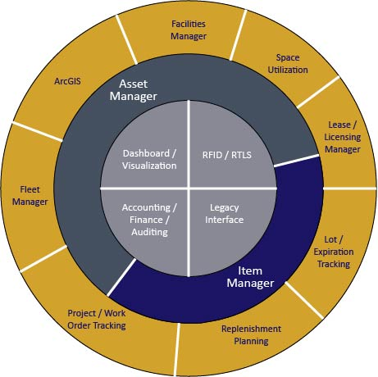
AVA™ Enterprise Manager Functional Components

Slide 4
AVA™ Manager Suite
AVA™ Asset Manager:
Defines facilities to the room level. Tracks assets (moveable and fixed) to the serial number level to individual rooms. Assigned ownership of each room within each facility. Establishes and tracks projects and work orders to document and monitor labor and non-labor costs. Automates the internal package delivery process by defining delivery routes and building manifests to deliver within the organization. Track employees, contractors and visitors who have access to assets. Performs physical inventory counting and reconciliation processes. Generates numerous operational and accounting reports.
AVA™ Item Manager:
Fully-featured, multi-entity, procurement, requisitioning, receiving, remote inventory, cross leveling and perpetual inventory management system. Full audit trails with transaction history. Multiple stockrooms allowed with individual reorder parameters established. Asset visibility option to include inventory levels from prime suppliers. Serial and lot number tracking available.
AVA™ RFID Tag Manager:
Upgrades Asset and Item Manager Applications to utilize RFID tags. Various RFID tag standards are supported including EPC Gen2 and Low-Energy Bluetooth. Tags are used for access control, in supply chain management to track inventory movement, to track files, laundry, garments, equipment assets such as wheelchairs, and high-cost or high-loss items such as electronics or tools.
Background:
AdvanTech, Inc. is proud to unveil our AVA™ Manager Suite. These applications are all based on three guiding principles of:
Accuracy, Visibility and Accountability.
These applications are browser-based, online, real-time using standard browsers and rely on a central encrypted relational database located in Annapolis or at your site.
Our systems are in operation throughout the U.S in multiple industries. Our goal is to assist our clients achieve substantial savings through implementation of advanced technology and best operational practices.

Slide 5
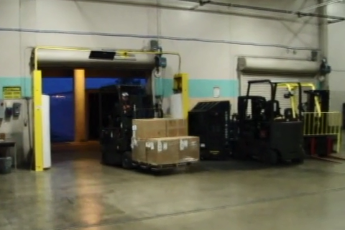
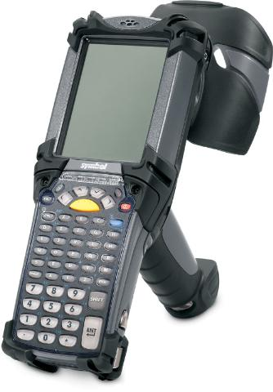

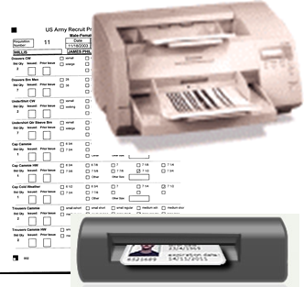
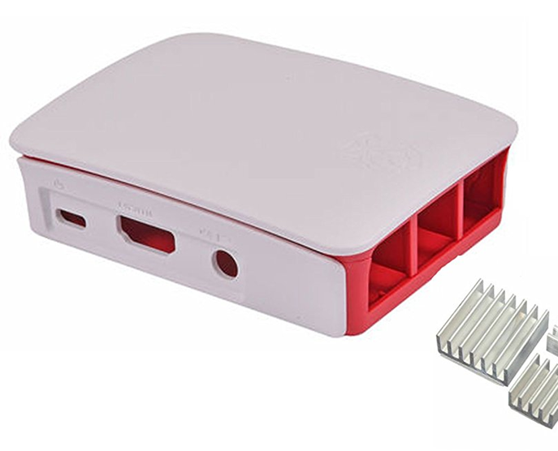
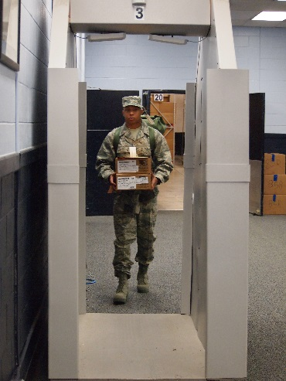
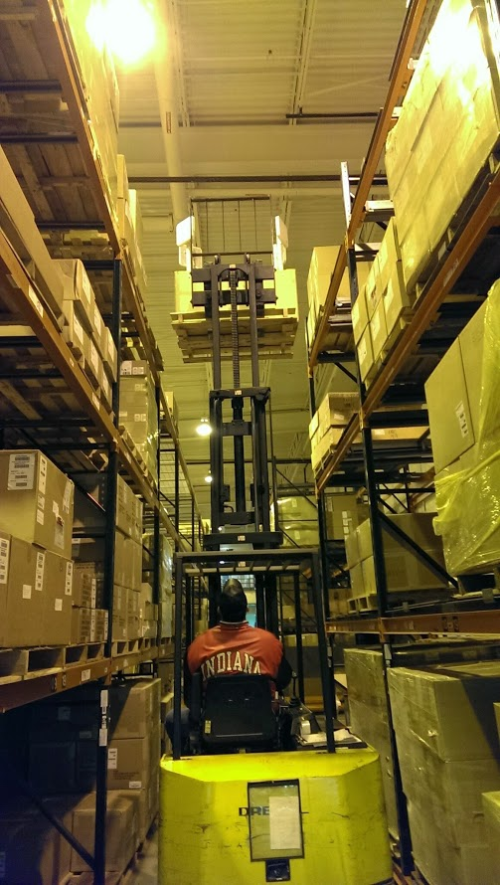
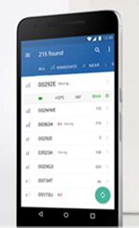
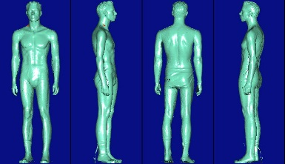


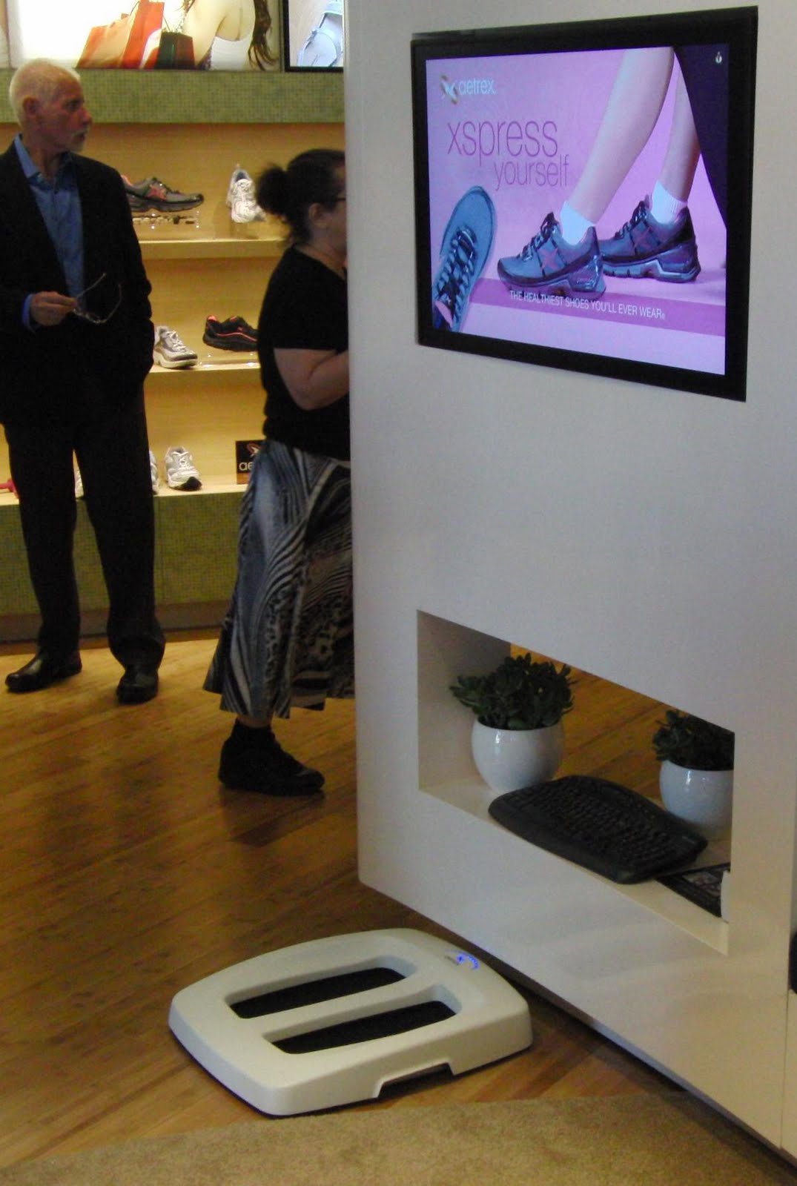


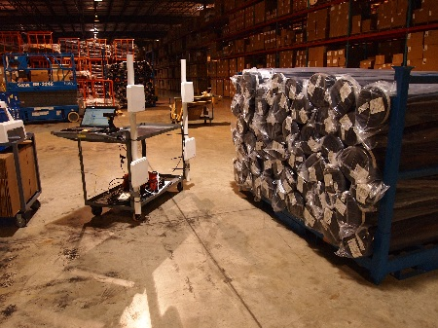
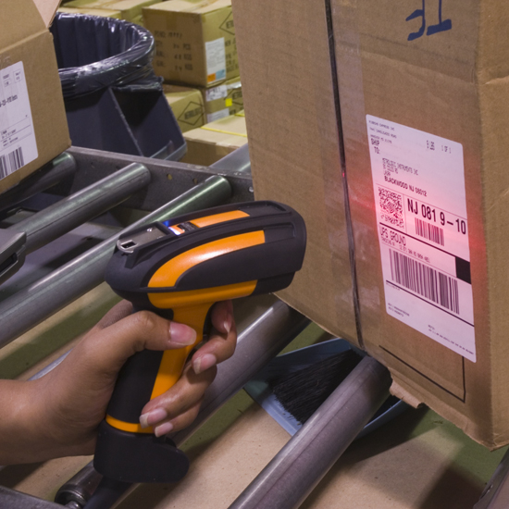
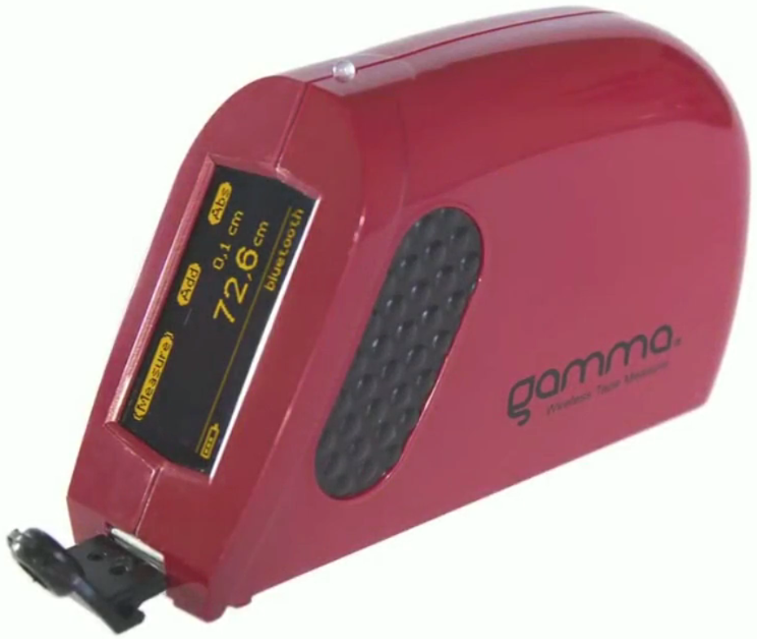
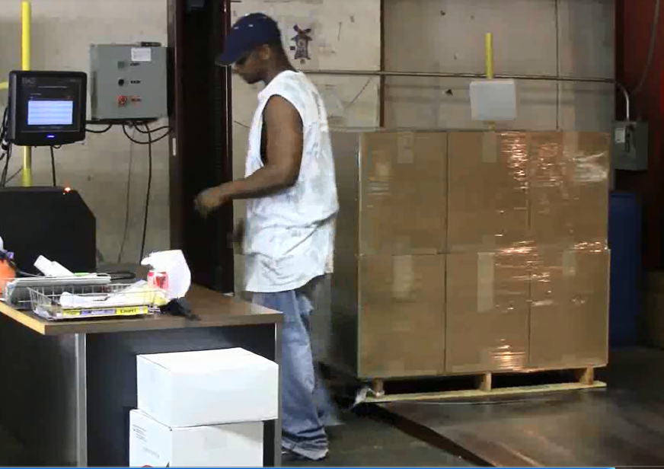
Automated Data Capture Technologies
RFID
LEB / RTLS
Measuring Devices
Others
OCR
Whole Body Scanning
Kinect
Voice Recognition
Foot Scanning
Bar Code
Hand Measuring

Slide 6
AdvanTech’s Fully Integrated Solution
AVA RFID Manager
Departmental Property Book
Individual Property Book
External Interfaces
AVA™ Item Manager
AVA™ Asset Manager

Slide 7
AVA™ Asset Manager – Questions????
Facilities:
Assets / Equipment:
What Facilities are included in my Organization?
Who occupies my Facilities?
What are the areas in Facilities used for?
Blueprints and other document stored online linked to facility, floor and room.
Fire Escape documentation.
What assets are in my Organization?
Where are these assets within my Facilities?
Who owns these assets?
What assets are out of service and for how long?
What assets have just arrived into my Organization?
What assets have excessive repair and maintenance costs?
When were the assets last counted and reconciled?
Which assets are owned versus leased or on consignment?
How do I dispose of obsolete and unusable assets?
What are my current depreciation amounts?
Replace vs Repair decisions
Projects / Work Orders:
People:
What Projects and Work Orders are still open?
What Projects and Work Order are being planned and/or approved?
What are the budgets for these Project and Work Orders?
Who is performing the work?
Where is the work being performed (on/off site)?
Roles of Staff within organization.
Visitor and Contractors allowed into the Facilities.
Certifications of Staff using or repairing Facilities or Assets.
How can I limit access to specific areas by Staff and Visitors?

Slide 8

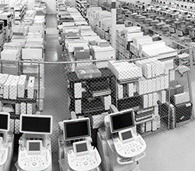
AVA™ Asset Manager – Equipment Tracking
Facilities / Building
Facility Type
Floors
    Rooms
    Room Usage
    Square Footage
    RFID / Barcode Assigned
    Systems
Asset / Item Master
Manufacturer
Model Number
Purchased From
Purchase Cost
Serial Number
RFID / Barcode Assigned
PO Number
Date Acquired
Data into Service
Room Inventory
Transaction History
Utilization History

Slide 9
AVA™ Asset Manager – Project Tracking
Facilities / Building
Facility Type
Floors
    Rooms
    Room Usage
    Square Footage
    RFID / Barcode Assigned
    Systems
Asset / Item Master
Manufacturer
Model Number
Purchased From
Purchase Cost
Serial Number
RFID / Barcode Assigned
PO Number
Date Acquired
Data into Service
Projects
Classification
Priority
Description
Status
Work Orders
Category
Priority
Description
Status

Slide 10

AVA™ Asset Manager – People Tracking
Facilities / Building
Facility Type
Floors
    Rooms
    Room Usage
    Square Footage
    RFID / Barcode Assigned
    Systems
People
Staff / Employees
Contractors
Visitors / Patients / Students
Department
RFID Tag ID
Facility Location (Building / Room)
Work Order Costing
Location Validation

Slide 11
AVA™ Asset Manager – Delivery Tracking
Facilities / Building
Facility Type
Floors
    Rooms
    Room Usage
    Square Footage
    RFID / Barcode Assigned
    Systems
Asset / Item Master
Manufacturer
Model Number
Purchased From
Purchase Cost
Serial Number
RFID / Barcode Assigned
PO Number
Date Acquired
Data into Service
Generate Delivery Bar Code Label
Stage deliveries by Delivery Zone
Generate Delivery Manifest for Delivery Zone
Electronic Signature with time and date stamp

Slide 12
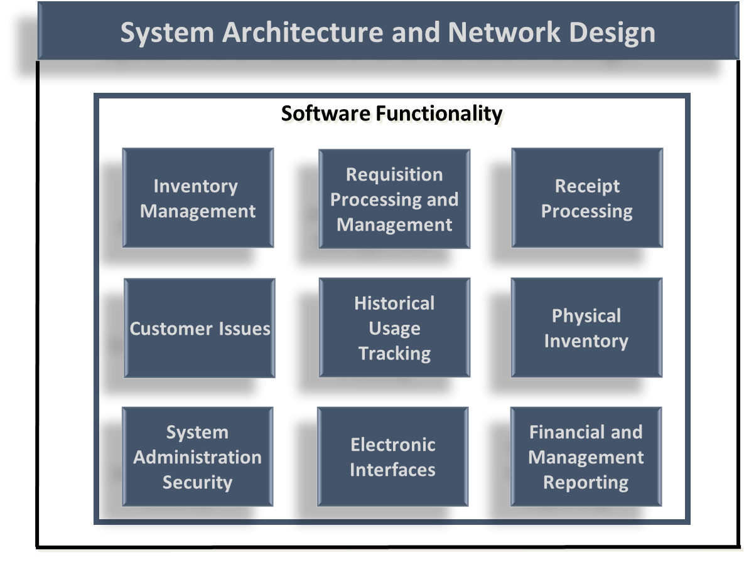
AVA™ Item Manager

Slide 13
AVA™ Item Manager
Standard Functions:
Single Master Catalog
Unlimited Individual Stockrooms
Visibility Of Prime Vendor On Hand Balances
Cross Leveling
Replenishment Of Remote Department-based Stockrooms
Automated Replenishment Level Calculations
Automated Replenishment Orders
Real Time Inventory Updates
On Demand Inventory Status And Expediting Reports
Multiple Inventory Valuation Formulas
Receiving And Put Away
General Ledger Interface For Posting Financial Transactions
Comprehensive Physical Inventory, Cycle Count And Reconciliation
Detailed, Read Only Transaction History
Barcode Enabled
Remote Departmental Requisitioning
Performance Management Reporting
Incorporated Non-stocked / Special Order Items
Other Available Functions:
RFID Integration
Serial Number / Lot Number Tracking
Asset Tracking And Real Time Location System (RTLS)
Electronic Advanced Shipping Notice To Automate Receipt Verifications
Package Tracking

Slide 14







Interfaced Systems
Listed below are the Systems AdvanTech AVA Systems have interfaced with

Slide 15
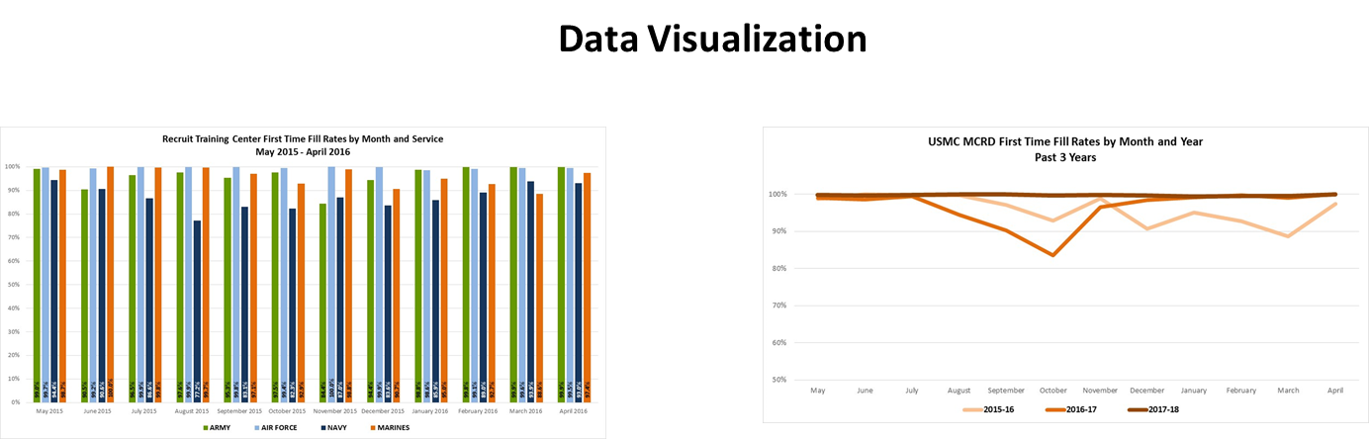
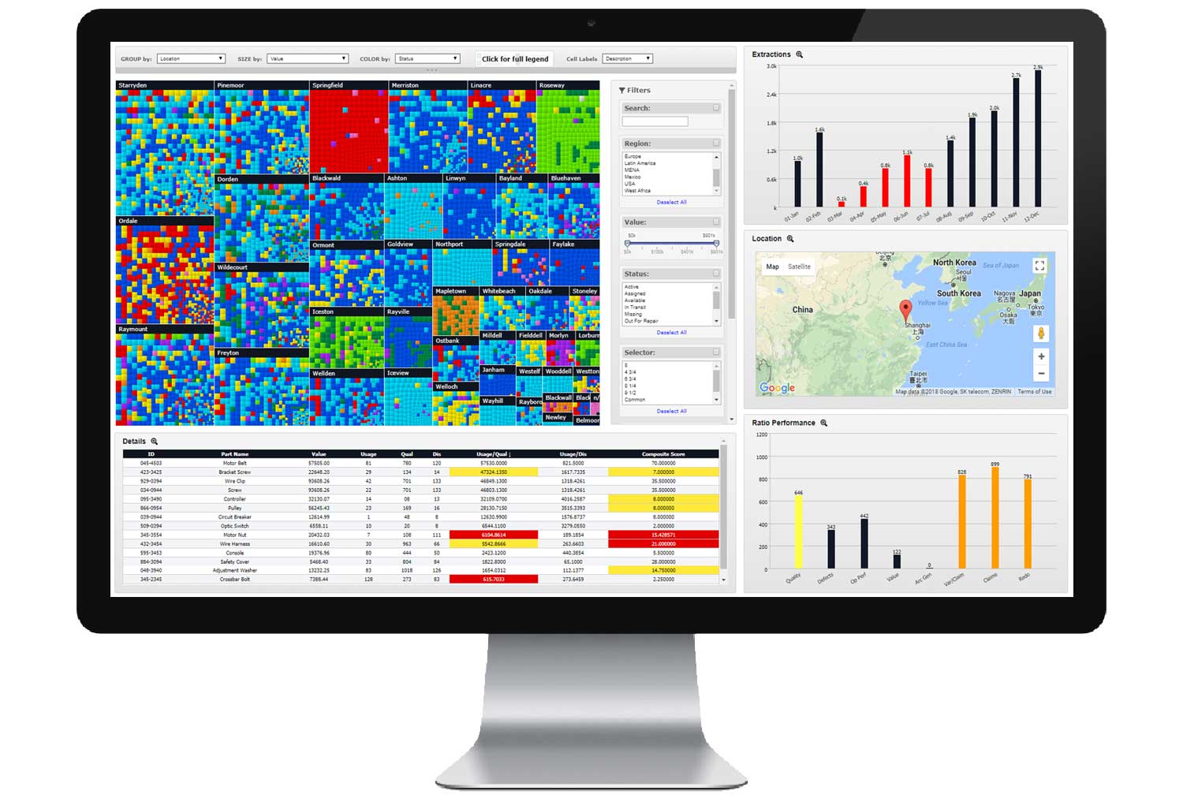
Dashboards / Business Intelligence
Overview of Flaremap® JS
“What you offer is far and away the best I have seen; and what I truly believe our clients have responded so strongly to is the innovation and thought leadership your team has.” - Director, Fraud Analytics

Slide 16

Dashboards / Business Intelligence
Flaremap® JS at-a-Glance
Flaremap JS integrates multiple data sources and embeds into existing processes—creating visual applications that help organizations monitor performance and manage risk.
Customers: Production use by Fortune 500 and government customers
Deployments: “Third Generation” Visual Applications
Product: Flaremap® JS
  Creates high-utility, data-dense workspaces
  Highly customized to process context
  Integrates with existing infrastructure
  Optimized for use across multiple platforms
  Flaremap Extensions Libraries for dashboards and operational deployments
Summary: Single screen, instant access, simultaneous interrogation of data sources, integrating multiple investigation processes
Performance Management:
Visual Analytics in Action

Slide 17

Dashboards / Business Intelligence
Flaremap® JS – Select Customers

Slide 18
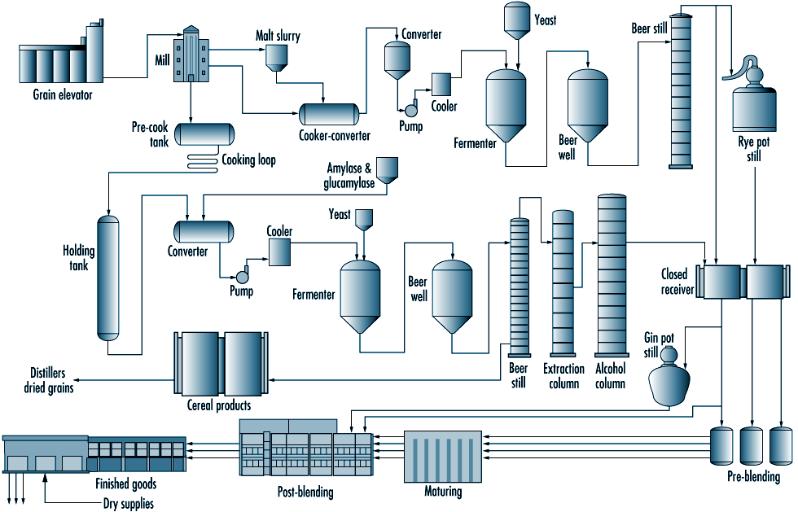
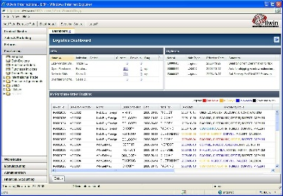
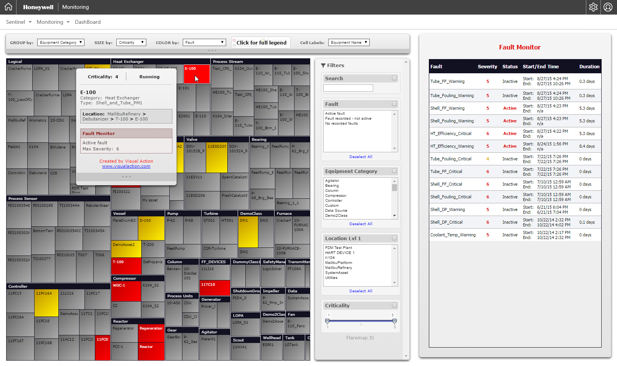
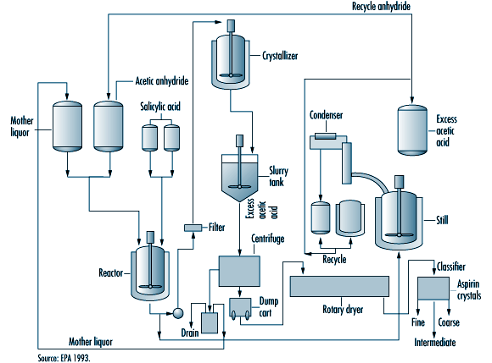
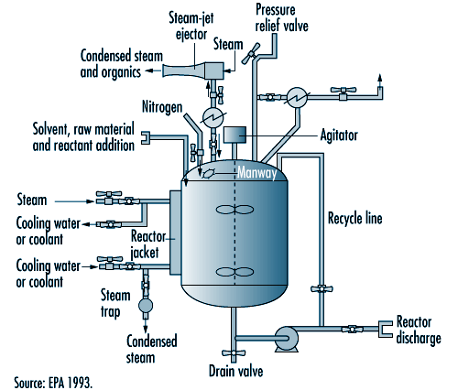
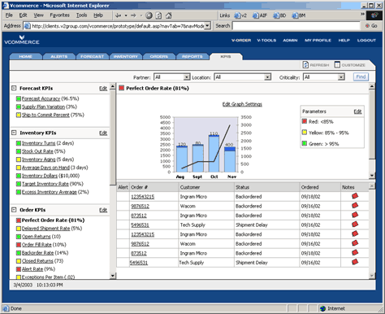
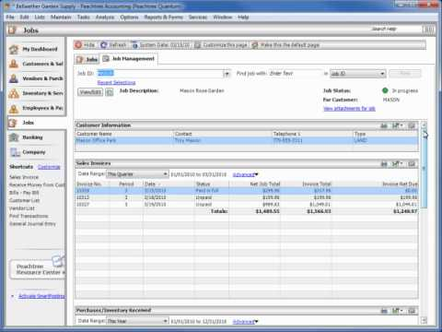
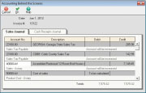
Dashboards / Business Intelligence
Unprecedented Visibility and Awareness
Before
With Flaremap
Many different systems required deep dives
Complicated effort to get to the source of the problem
Anomalies are driven to the surface
Hovering over an item instantly explains the situation

Slide 19
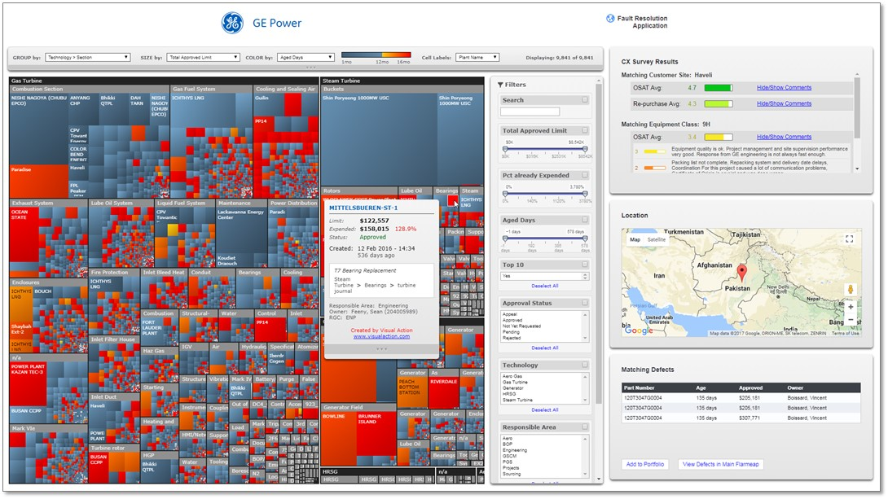
Dashboards / Business Intelligence
Example: Fault Resolution in Operations

Slide 20
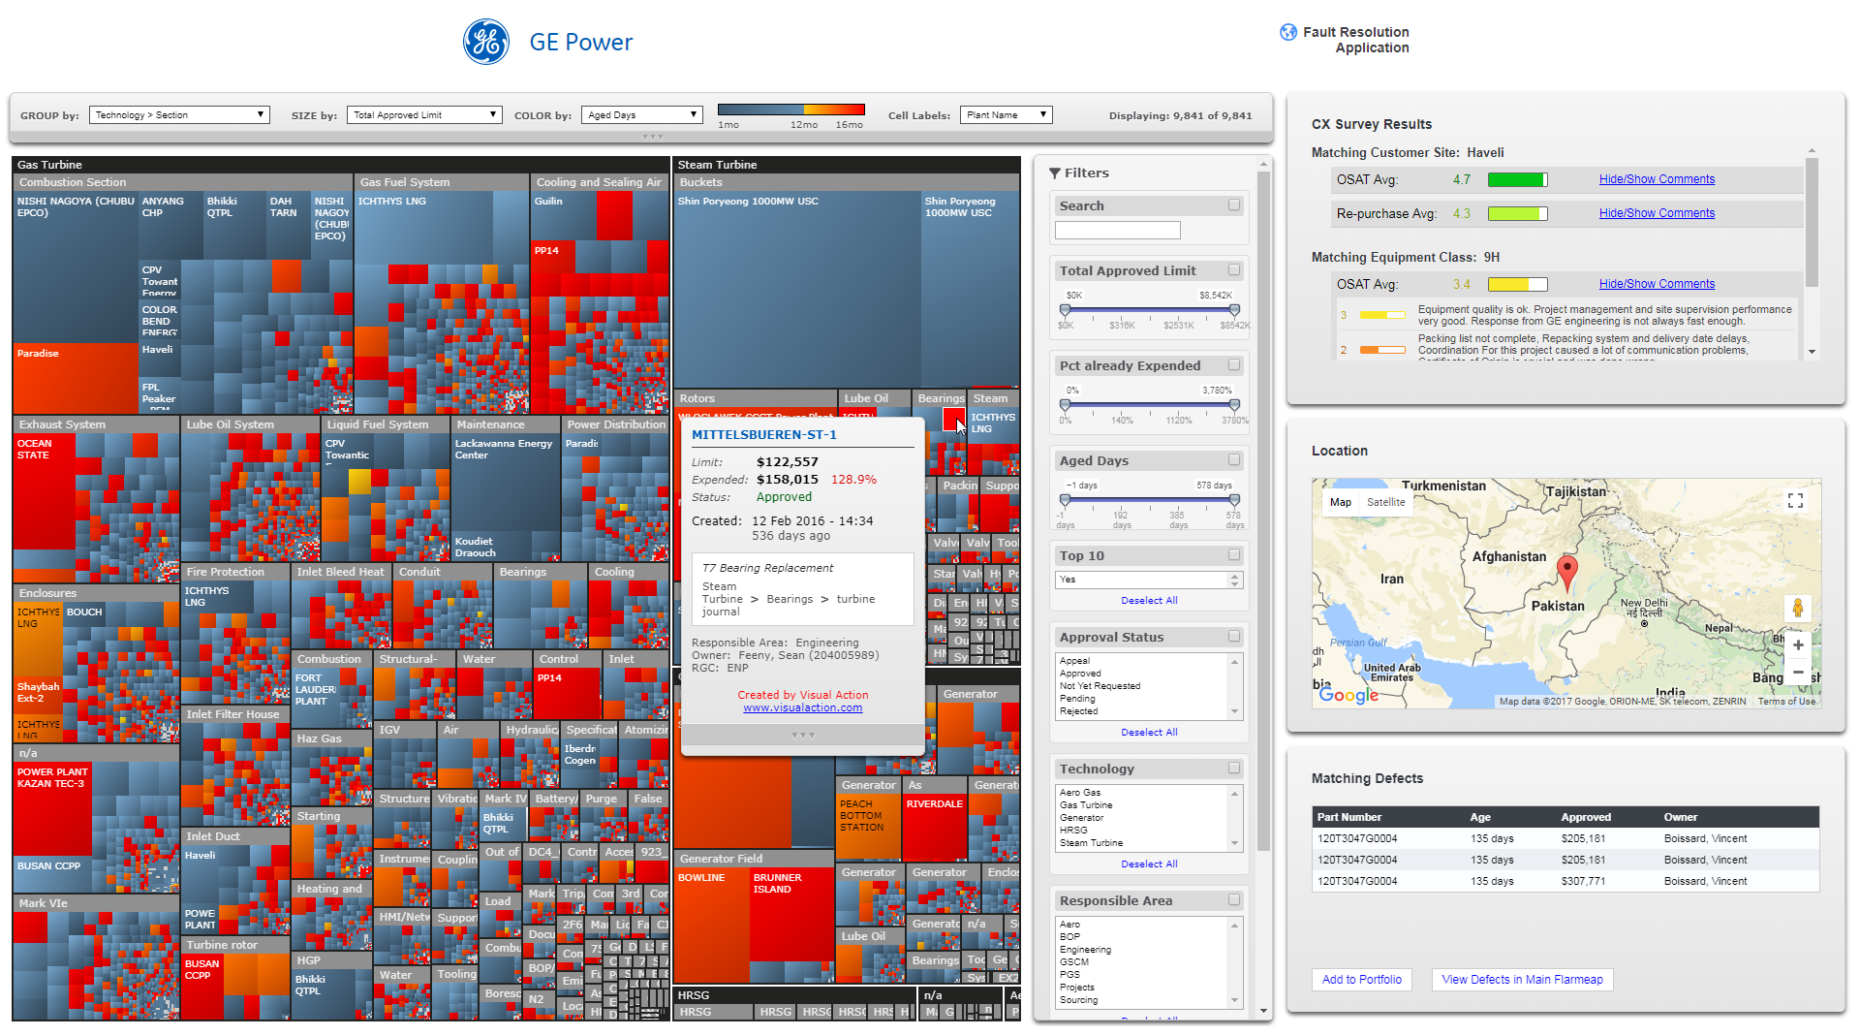
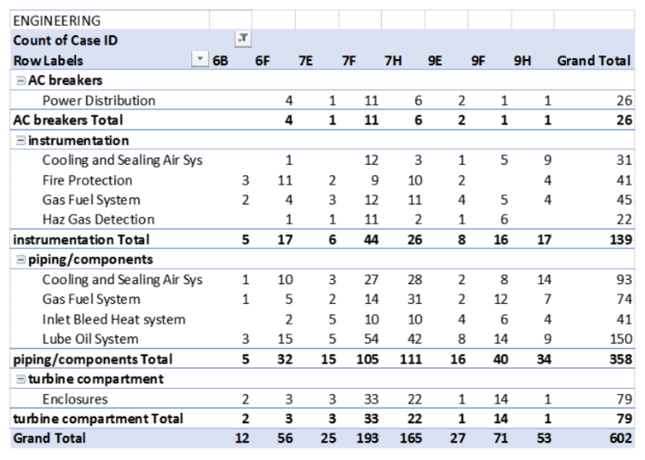

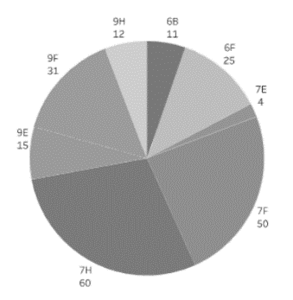
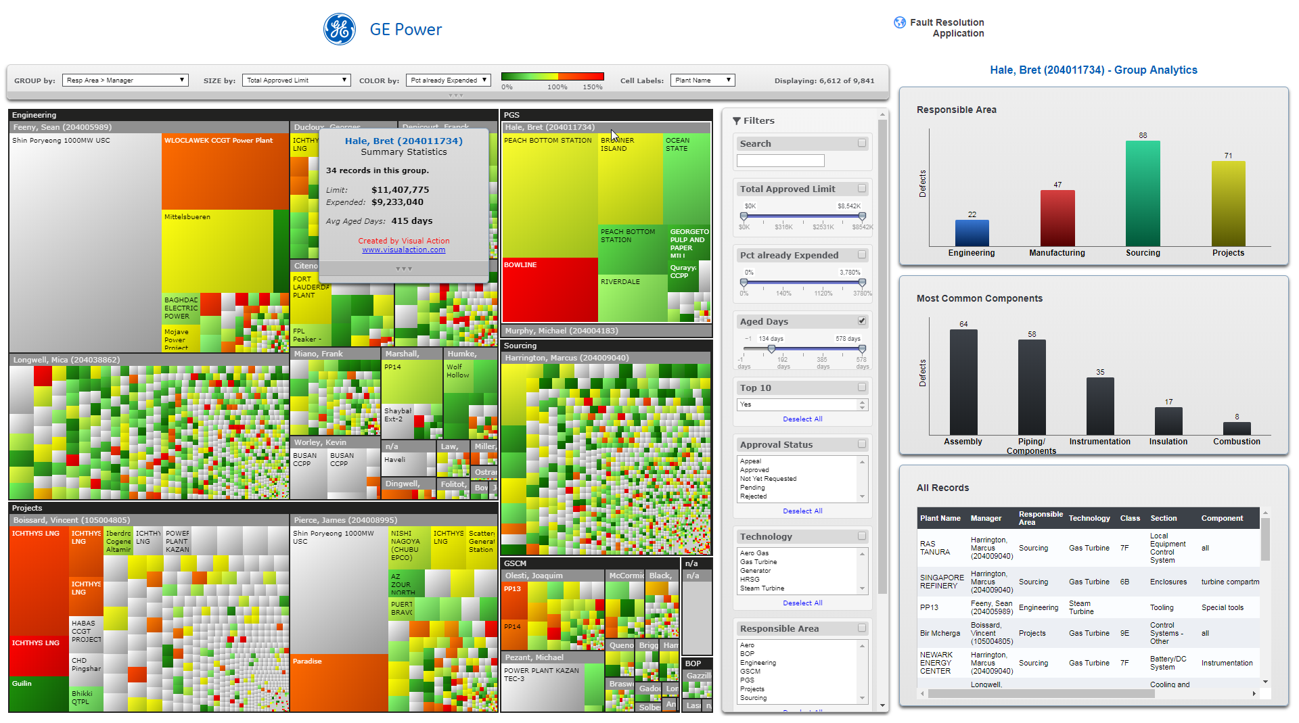
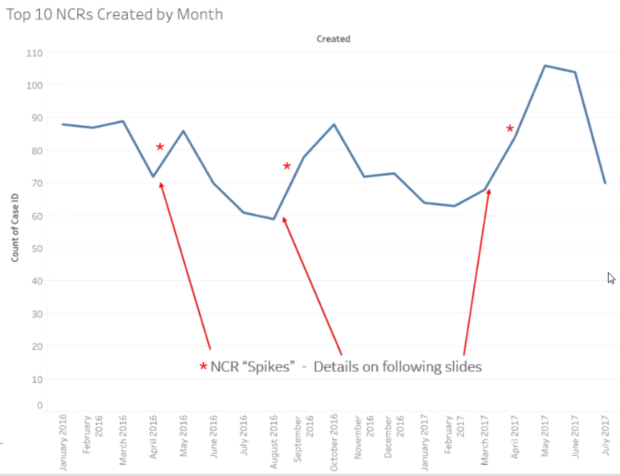
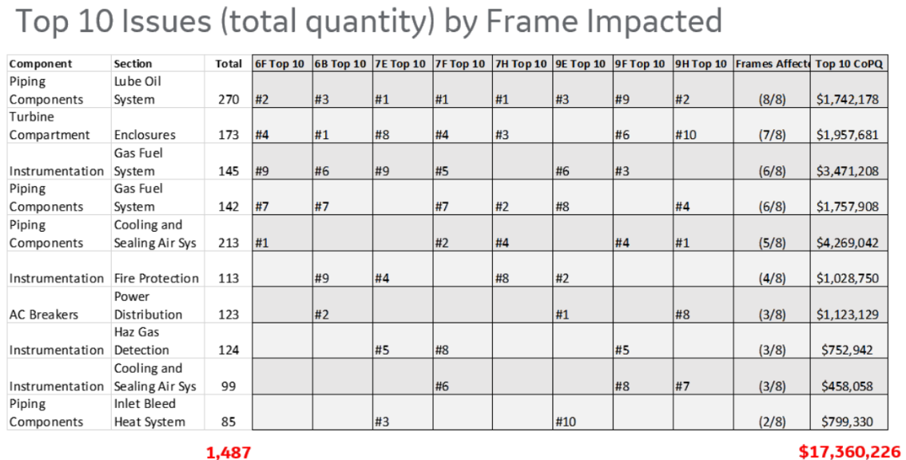
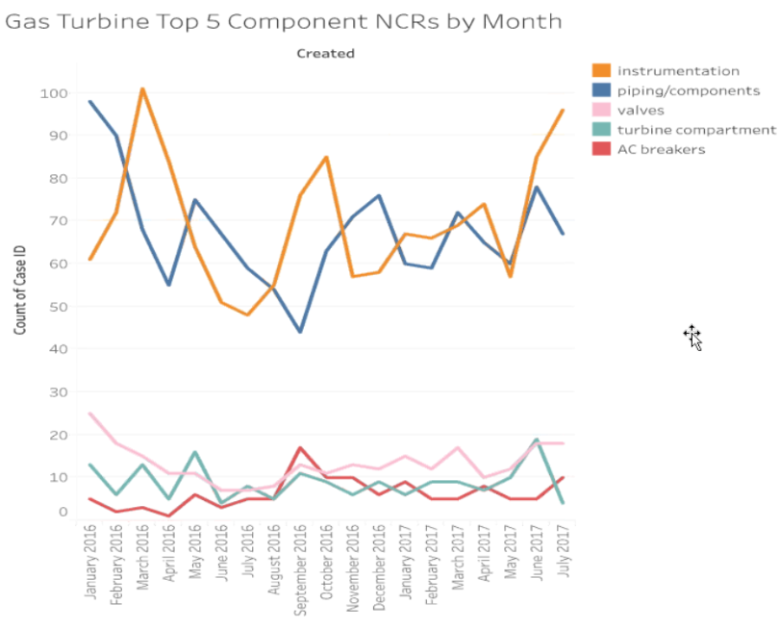
Dashboards / Business Intelligence
Holistic and Consistent Comprehension
Before
With Flaremap
Pages of reports, multiple analysis methods
Poor visibility to problems
Hard to understand, inflexible
New queries manually intensive – could take days
All 8,000+ ($130M) defects on one screen
Dynamic, instantaneous analysis at your fingertips
Always updated with the latest data
Fully interactive – and can be viewed on any device

Slide 21
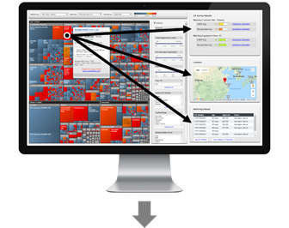
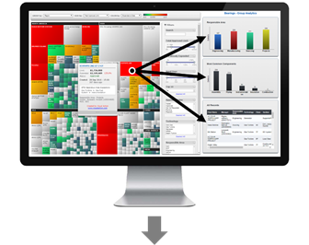
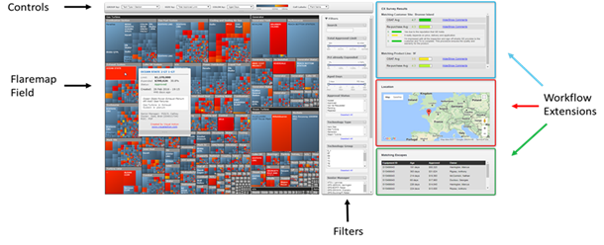
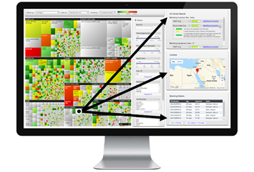
Dashboards / Business Intelligence
Flaremap Workflow Extensions
Interactive extensions that facilitate day-to-day workflow.
Deliver a synchronized, context-relevant and integrated interface.
Custom-developed for speed, flexibility and compatibility.

Slide 22
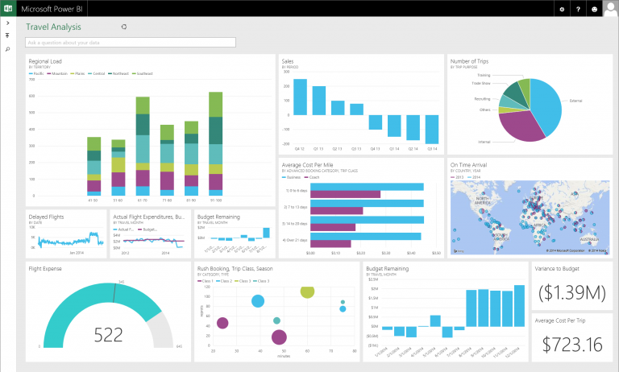
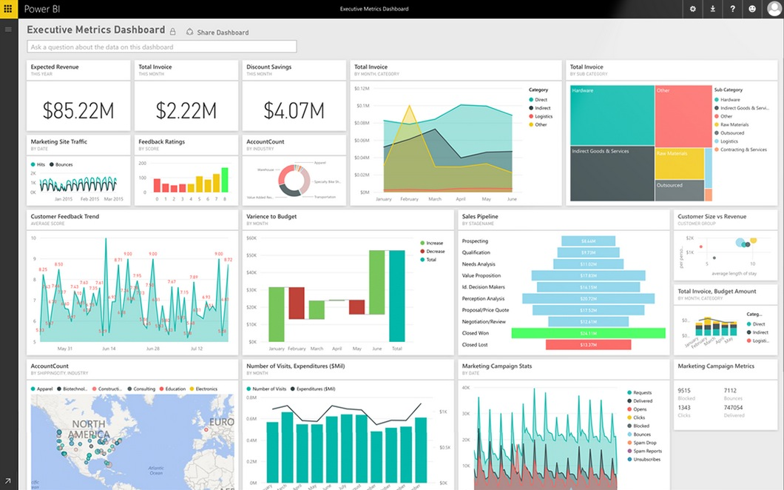
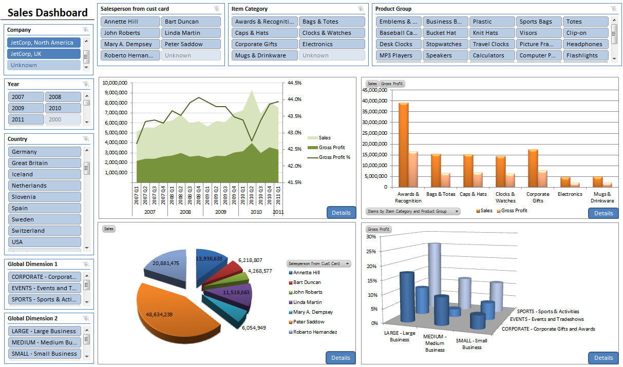
Dashboards / Business Intelligence
Business Intelligence Examples – Graphical Reports

Slide 23

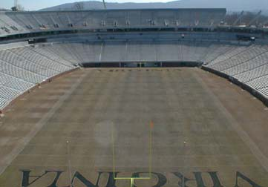

RFID Overview – Technologies Available
Category Specifications Reading Range
GPS
Transmitter
Satellite Reader
Satellite Receiver
Active RFID
Reusable Transmitter with internal power source
Multiple Fixed Readers
Extension of LAN / WAN
Low Energy Bluetooth
Reusable Transmitter with internal power source
Smaller Form Factor than Active RFID
Smartphone Compatible
Passive RFID
Disposable Transmitter with external power source
Fixed Reader with Multiple Antennas and/or Handheld Readers

Slide 24

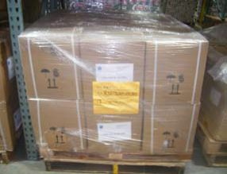

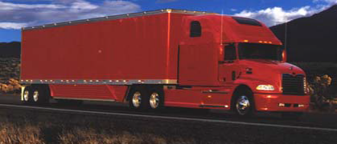
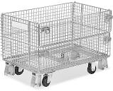
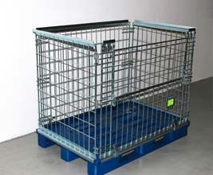
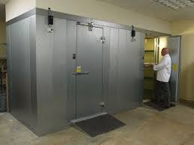
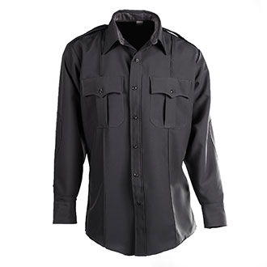
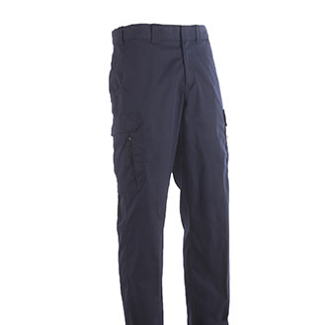
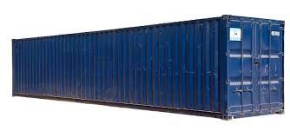





RFID Overview – Technologies Available
GPS
Active RFID
Low Energy Bluetooth
Passive RFID
Toll Pass
Metal Containers
Cartons / Boxes
Tractor Trailer
Pallets w/ Boxes
Refrigeration Units
Apparel
Shipping Container
Firearms
Fork Lifts
Staff/ Visitors
Document / Records / Books

Slide 25







RFID Overview – Passive RFID Components
RFID Printer / Encoder
Fixed Reader and Antennas
Permanent Tags
Handheld Reader

Slide 26






RFID Overview – pRFID Reader Configurations

Slide 27



Low Energy Bluetooth Solutions
AdvanTech, Inc.
Low Energy Bluetooth Solutions
Our product is a solution that includes beacons, readers, apps, and software to track assets in warehouses, yards, offices, hospitals, etc.
Readers
Beacons / Tags
Deploys rapidly
Analyzes data
Smart notifications

Slide 28
Automated Data Capture Performance Matrix
Facility/ Structural Limitations
Reading Distance
Read Direction
Automated Reading
Network Required
Technology
Cost
Triangulation
Less than $0.03 per tag/label
Under 18 inches
Line of Sight
Conveyor
Required
Ethernet/ WiFi
Barcodes
No
Yes
Passive RFID
Between $0.10 and $8.00
Under 32 Feet
With Fixed Readers
Ethernet/ WiFi
Conical
No
Yes
Between $15.00 and $50.00
Up to 300 feet
With Fixed Readers
LEB
Spherical
Yes
No
Mesh
Over $65.00
Up to 500 feet
Exterior Locations Only
With Fixed Readers
Active
Spherical
Yes
Mesh
Notes:
Bar Codes – Require Line of Site
Passive RFID – Will not go through Concrete, water. Metal structures can distort signal and locations
LEB – Basic concrete walls and floors are no problem, Water and other environmental conditions no problem
Active – More geared to outside yards where mesh networking would be advantageous

Slide 29








RFID Tag Location (pRFID vs LEB)
24’
LEB Coverage
8’
8’
24’
pRFID Coverage

Slide 30
Hardware Cost Comparison (pRFID vs LEB)
Tags for Pieces of Equipment
(300)
RFID Printer / Encoder
(1)
Fixed RFID Readers for 10 areas (20)
Handheld RFID Readers
(2)
Passive RFID
$500
$2,780
$40,000
$3,600
$46,880
Low Energy Bluetooth
$5,000
$0.00
$12,000
$0.00
$17,000
Lower Reader Cost
No visible Antennas
($29,880)
Higher Tag Cost
Larger Read Range
Printer not Required
Smart Phone Application

Slide 31



RFID Overview – RFID Architecture
AdvanTech Private Cloud
Annapolis, MD
Central Data Warehouse
Secure VPN
AdvanTech HQ
Read Point Controller

Slide 32






RFID Overview – RFID Architecture
RFID Readers
Inventory
Manager
Read Point Controller
Asset
Manager
RFID Data
Manager
Central Data Warehouse
Email
Legacy Systems

Slide 33
End to End Supply Chain Integration Process
Points of RFID Integration
Manufacturer
Wholesale
Retail (End-User)
Receiving and Storage
Point of Sale
1
2
3
4
5
6
7
8
9
Packaging
F/G
Shipping
Receiving
Repackaging
Shipping
Receiving
Stock Movements
Sale
RFID on Pallet
RFID on Carton
RFID on Item

Slide 34

RFID Overview – Shared Integration
Central Data Warehouse
Item Master
Tag Data
Serial / Lot
Contract / PO
Manufacturer
Wholesale

Slide 35
Documented Operational Improvements
Operational Activity | Documented Results
Production Control | Reduced Quality Checks by 20 hours per week
Receiving | Reduced Receiving Time to 20 Minutes from 3 hours
Point of Sale | Processed Platoon of 50 Recruits in 1 hour down from 2.5 hours
Physical Inventory Counting | Reduced Counting Time to 6 hours from 2 days
Physical Inventory Variance | Variances reduced to 0.18% from 5%-8%

Slide 36
Thank you for your Interest

