Slide 1
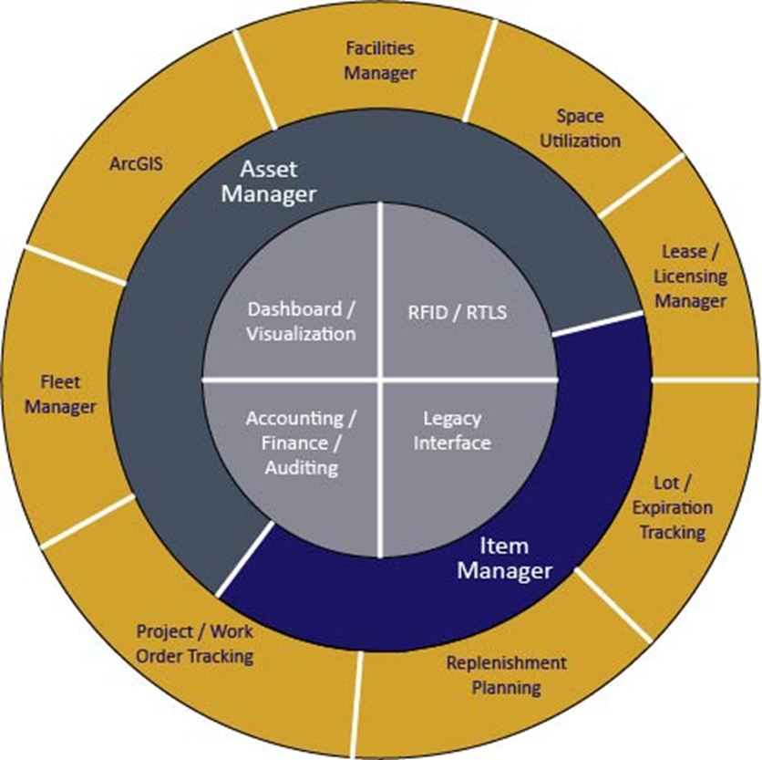
AVA™ Enterprise Manager Suite
Sample Screens

Slide 2
AVA™ Manager Suite
AVA™ Asset Manager:
Defines facilities to the room level. Tracks assets (moveable and fixed) to the serial number level to individual rooms. Assigned ownership of each room within each facility. Establishes and tracks projects and work orders to document and monitor labor and non-labor costs. Automates the internal package delivery process by defining delivery routes and building manifests to deliver within the organization. Track employees, contractors and visitors who have access to assets. Performs physical inventory counting and reconciliation processes. Generates numerous operational and accounting reports.
AVA™ Item Manager:
Fully-featured, multi-entity, procurement, requisitioning, receiving, remote inventory, cross leveling and perpetual inventory management system. Full audit trails with transaction history. Multiple stockrooms allowed with individual reorder parameters established. Asset visibility option to include inventory levels from prime suppliers. Serial and lot number tracking available.
AVA™ RFID Tag Manager:
Upgrades Asset and Item Manager Applications to utilize RFID tags. Various RFID tag standards are supported including EPC Gen2 and Low-Energy Bluetooth. Tags are used for access control, in supply chain management to track inventory movement, to track files, laundry, garments, equipment assets such as wheelchairs, and high-cost or high-loss items such as electronics or tools.
Background:
AdvanTech, Inc. is proud to unveil our AVA™ Manager Suite. These applications are all based on three guiding principles of:
Accuracy, Visibility and Accountability.
These applications are browser-based, online, real-time using standard browsers and rely on a central encrypted relational database located in Annapolis or at your site.
Our systems are in operation throughout the U.S in multiple industries. Our goal is to assist our clients achieve substantial savings through implementation of advanced technology and best operational practices.

Slide 3
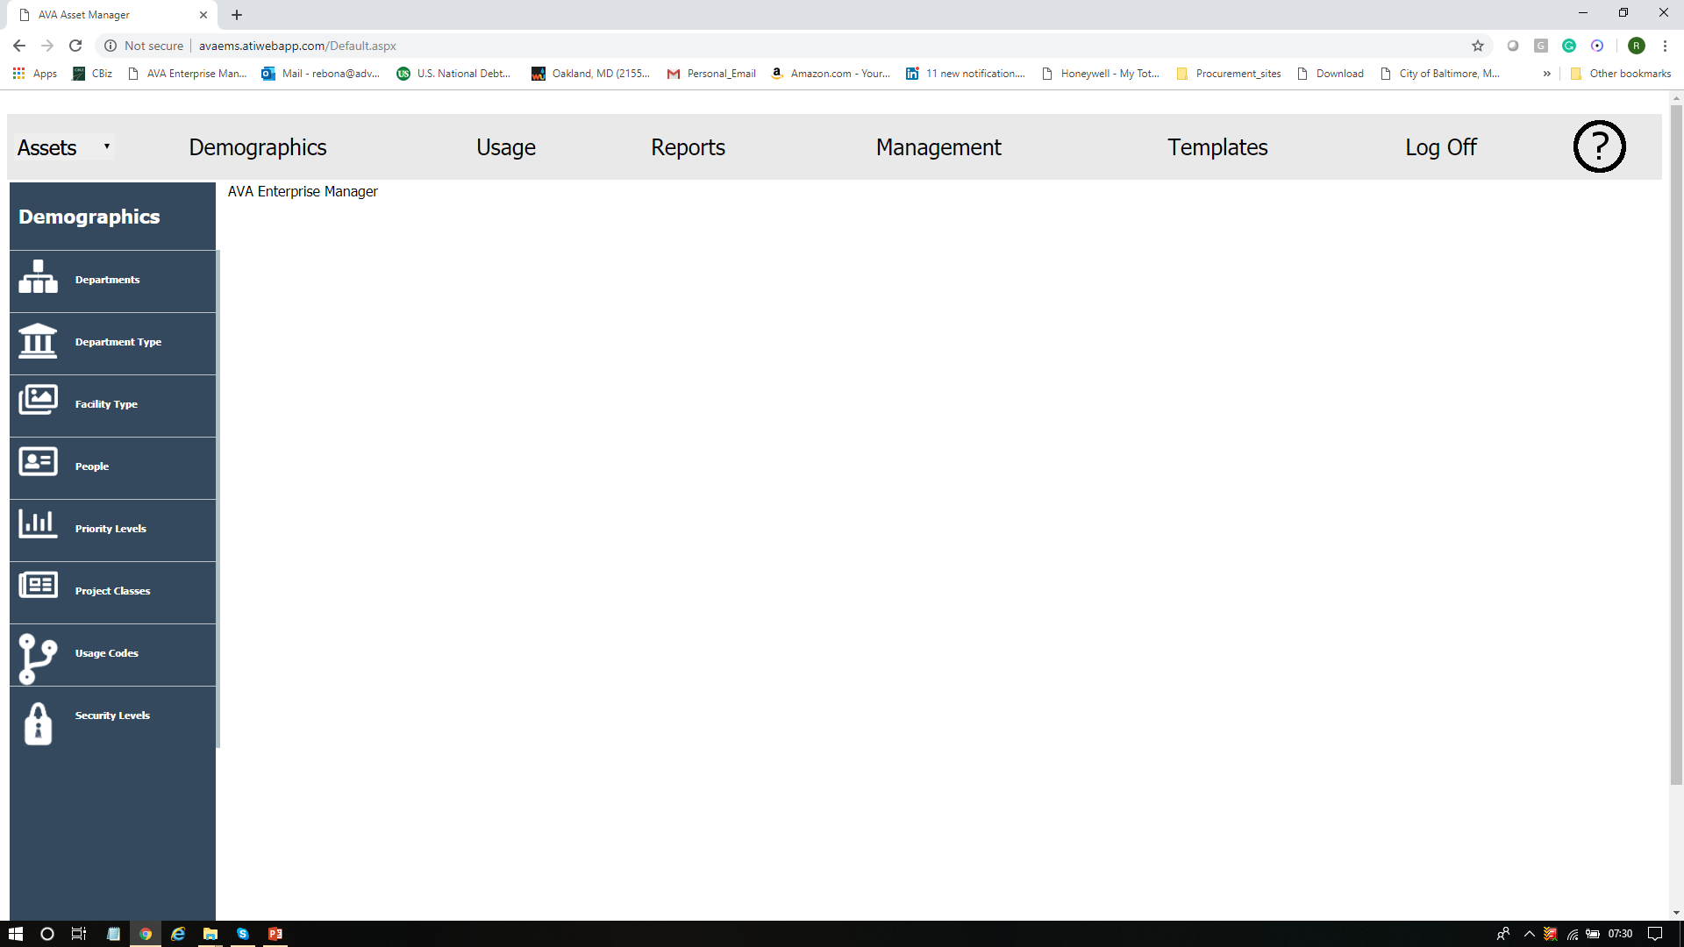
Demographics Main Menu

Slide 4
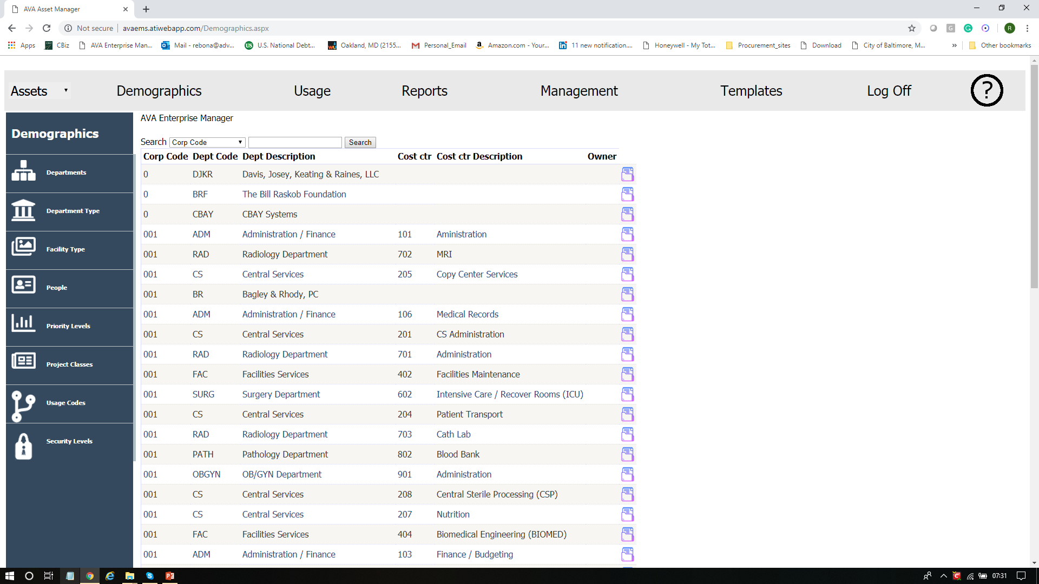
Departments / Cost Centers

Slide 5
Department Classifications

Slide 6
Facility Classifications

Slide 7
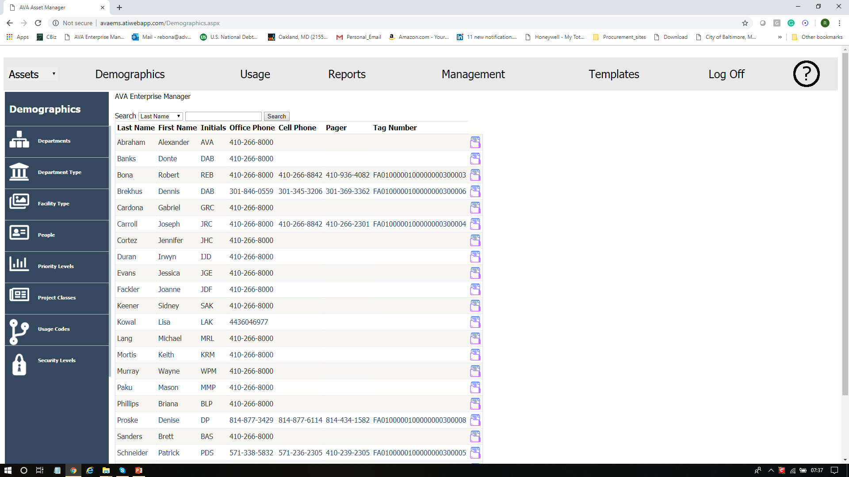
People

Slide 8
Project / Work Order Priorities

Slide 9
Project / Work Order Classifications

Slide 10
Room Utilization Classifications

Slide 11
Asset / Supply Security Levels

Slide 12
Facilities List

Slide 13
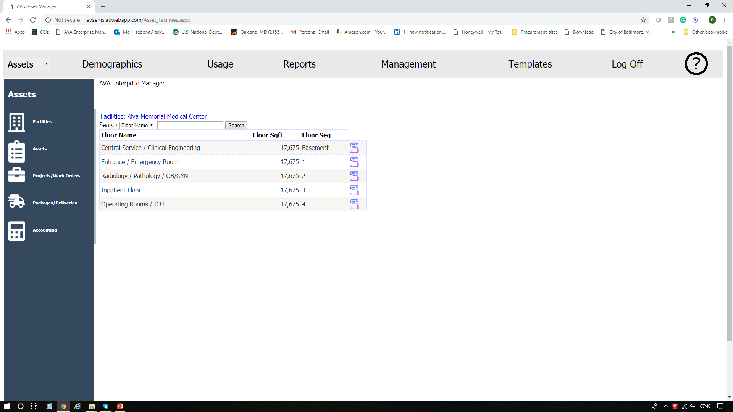
Floors within a Facility

Slide 14
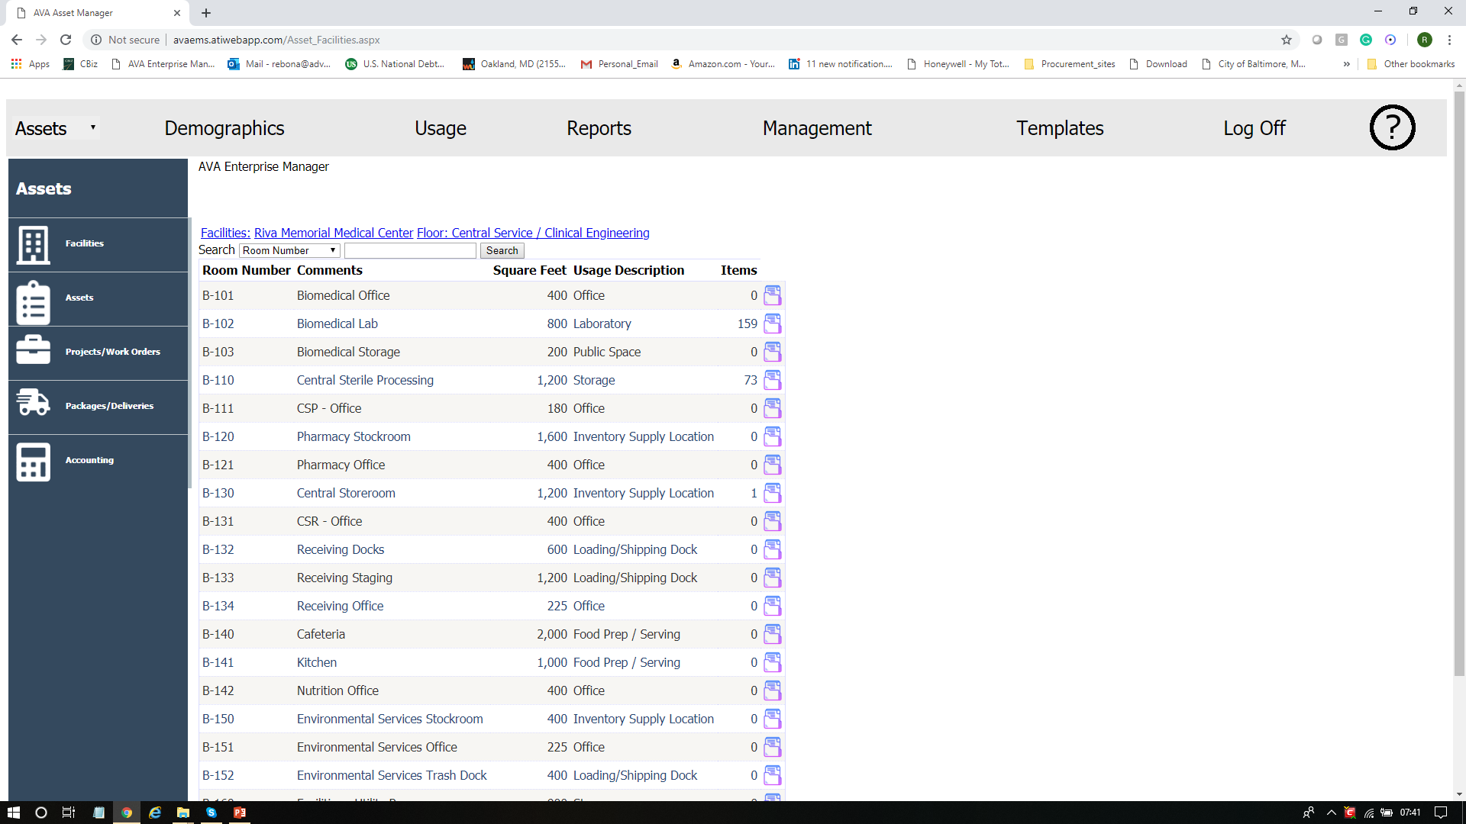
Rooms on a Floor

Slide 15
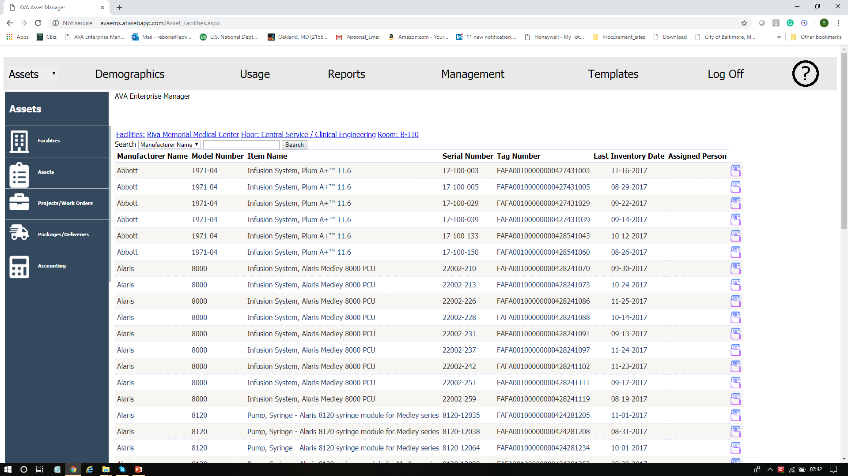
Assets in the Room

Slide 16
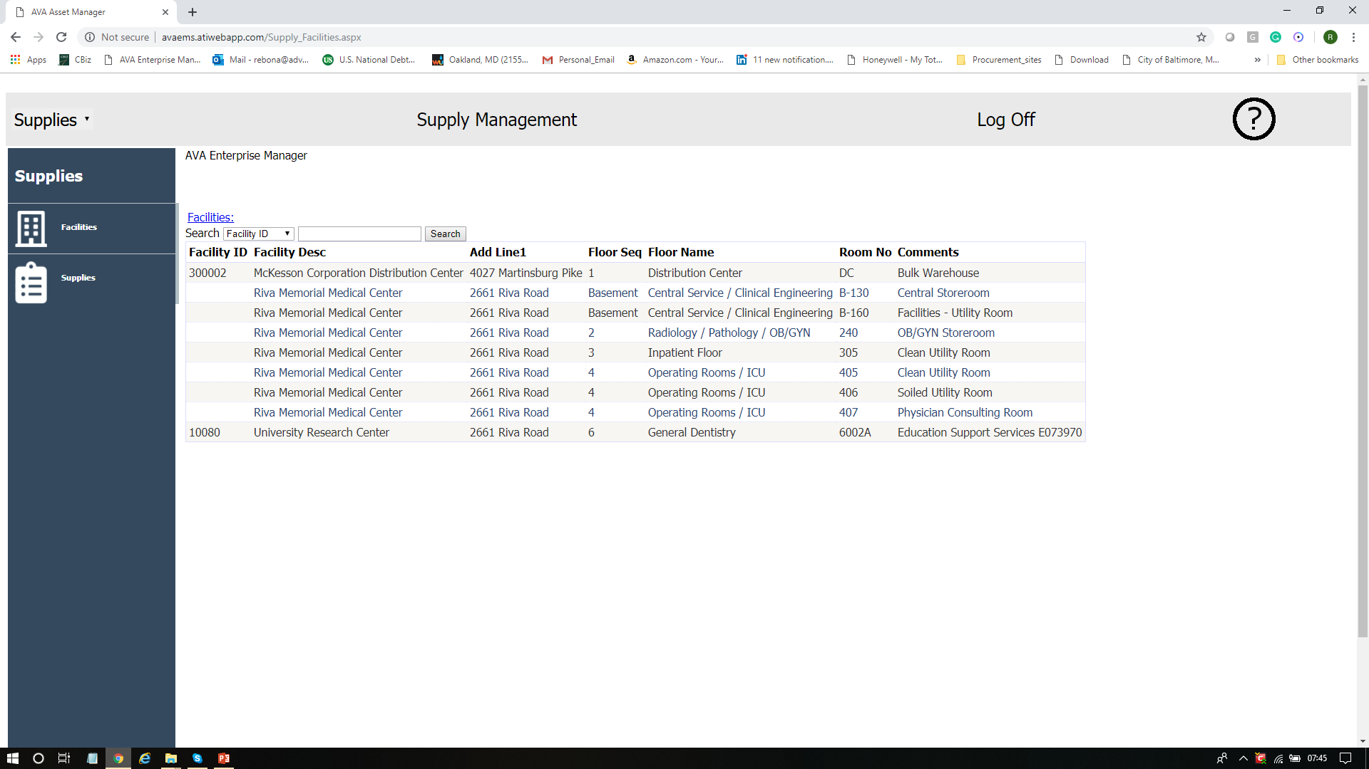
Rooms containing Consumable Supplies

Slide 17
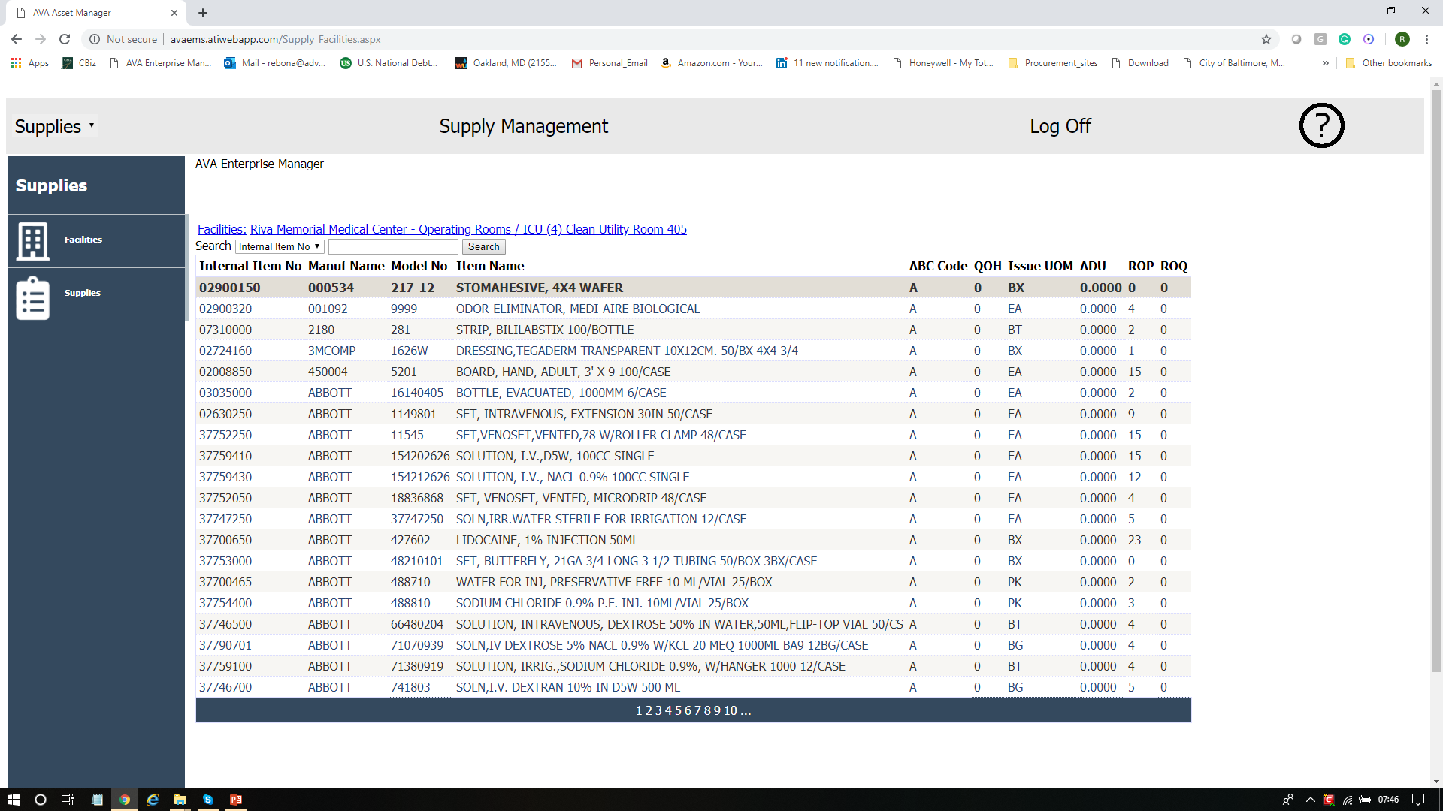
Consumable Supplies within the Room

Slide 18
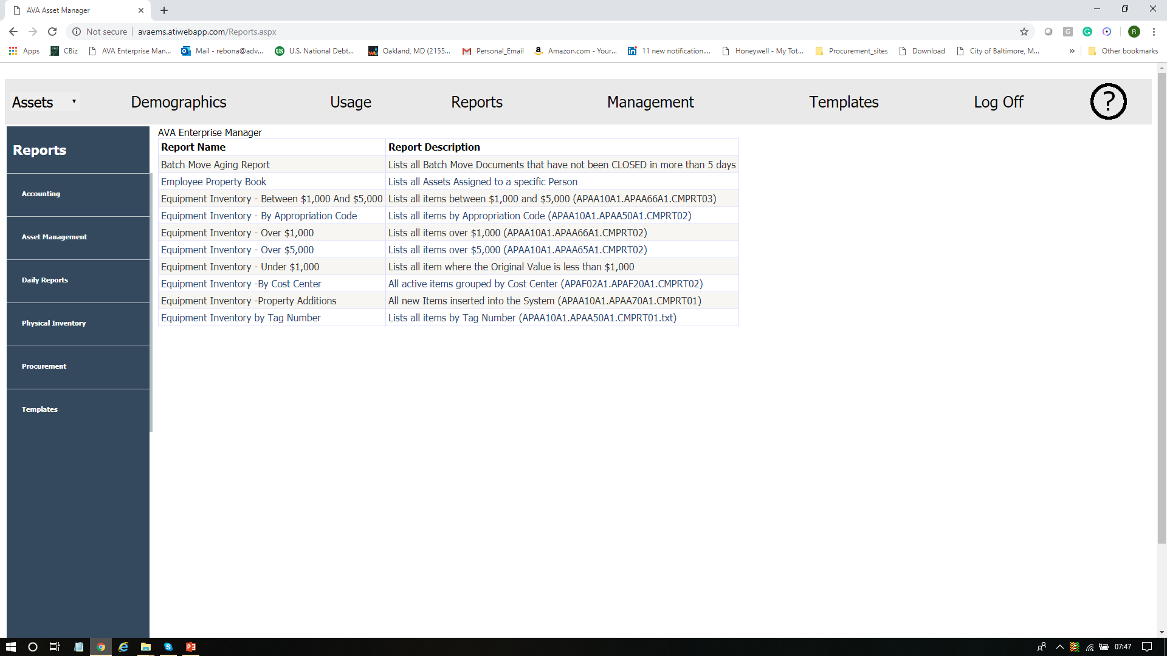
Asset Management Report

Slide 19
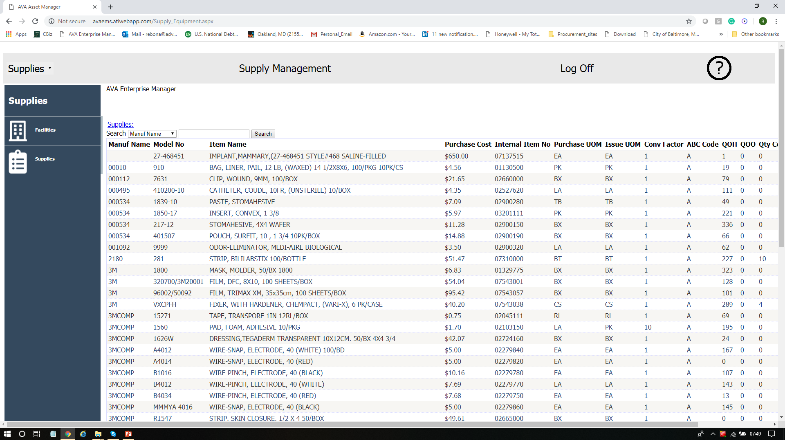
Supply Visibility

Slide 20
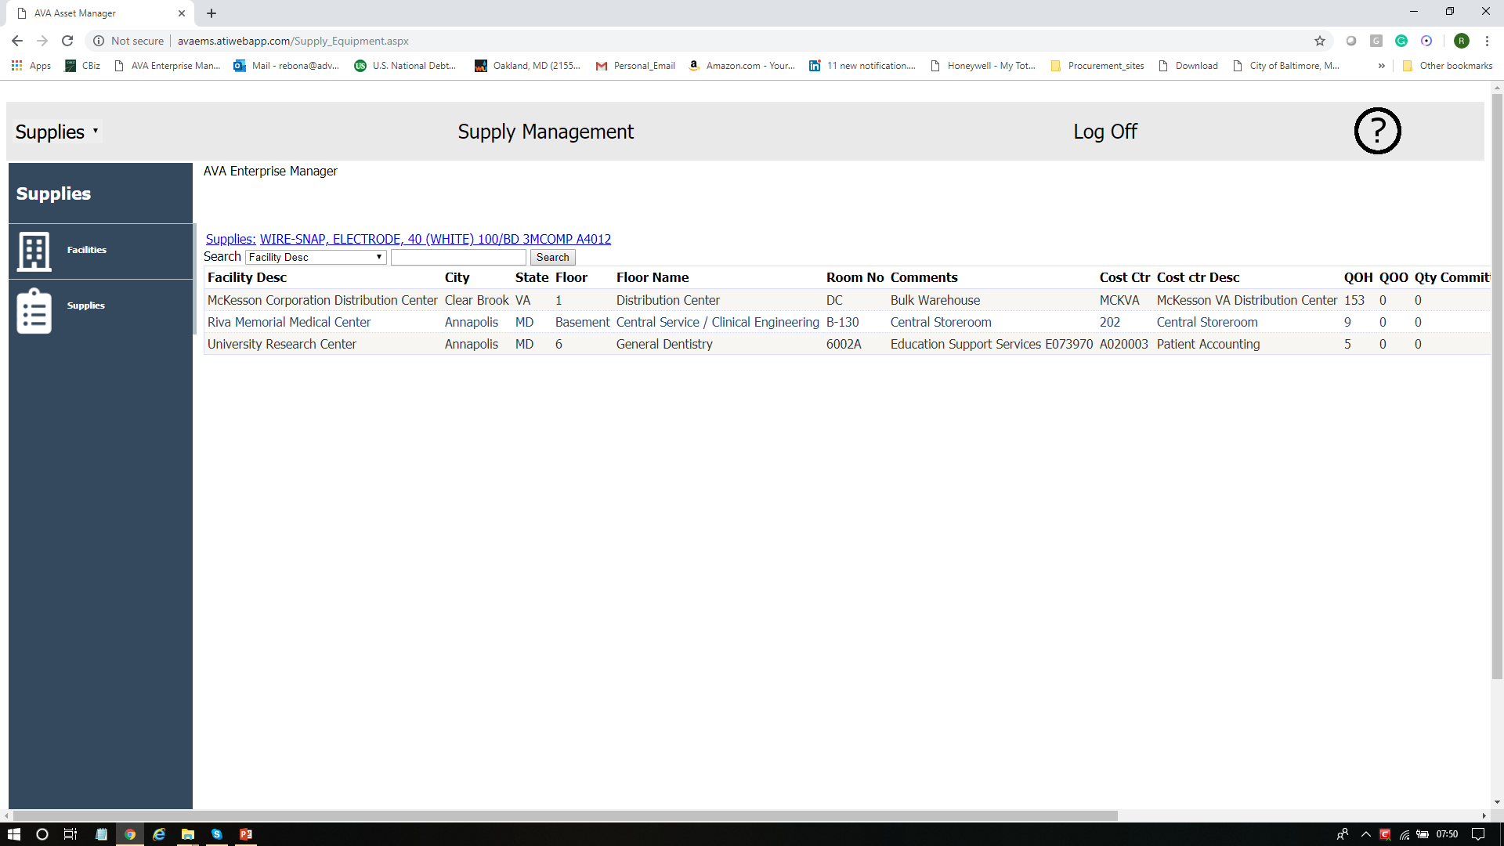
Supply Visibility – Rooms where Supply is stored

Slide 21
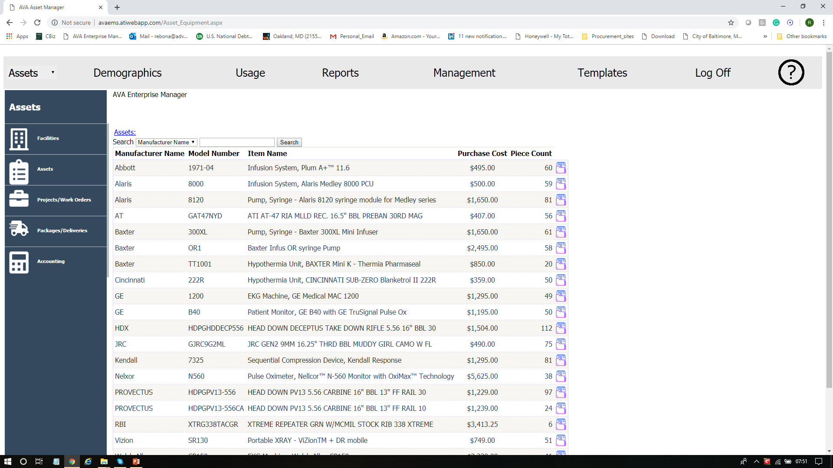
Asset Visibility

Slide 22
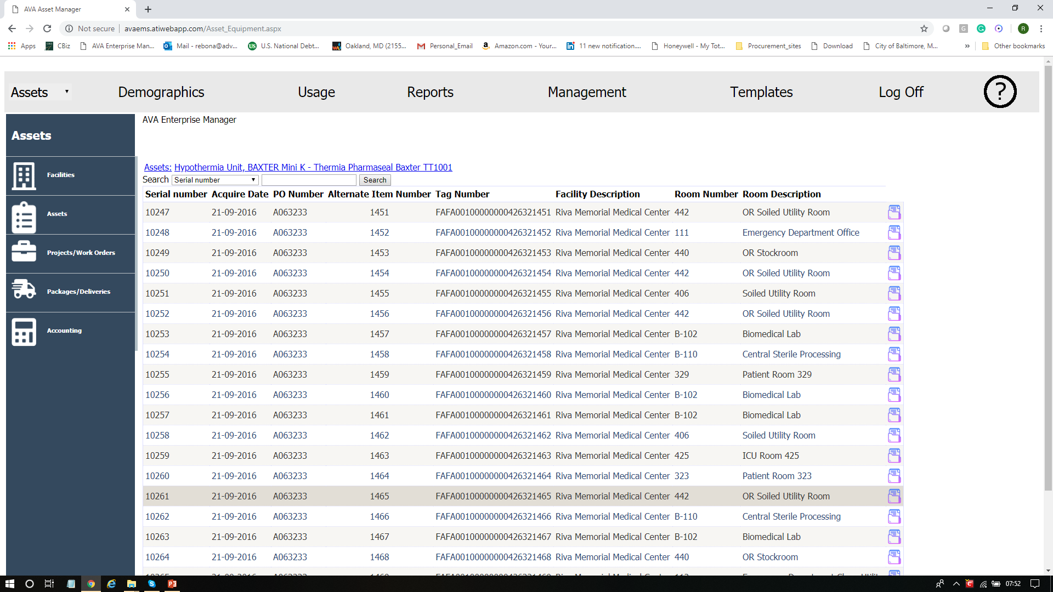
Asset Visibility – Locations by Serial Number

Slide 23
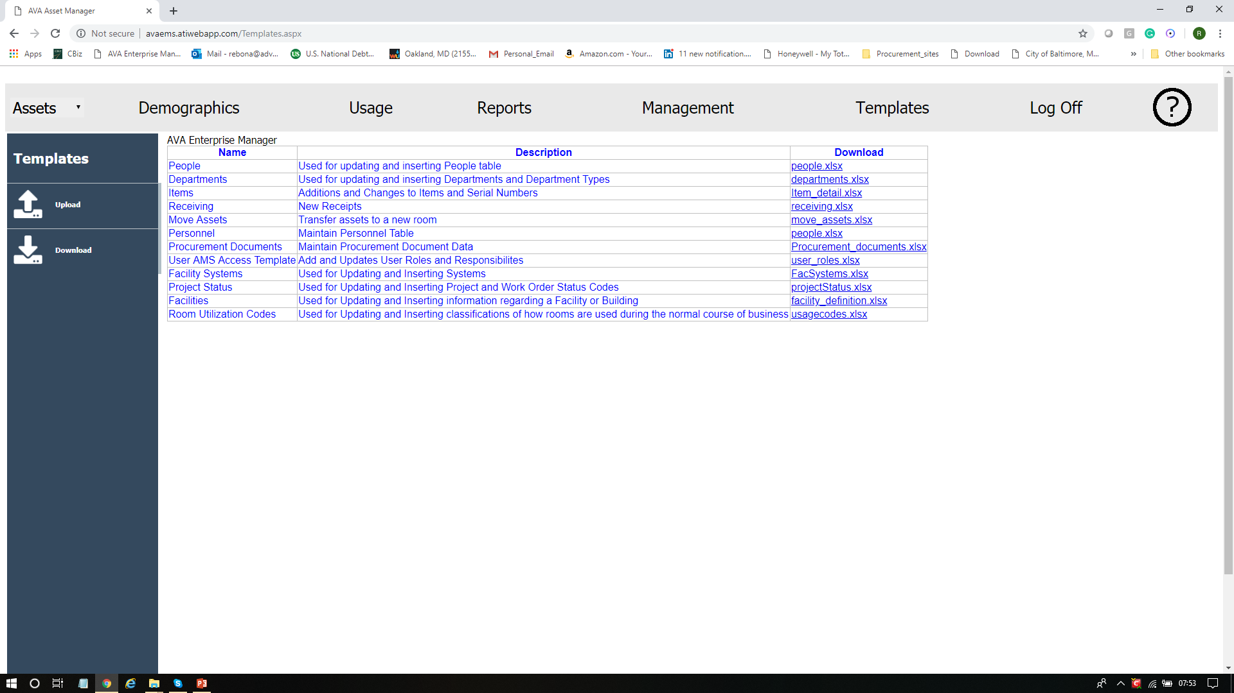
Template Selection Screen (Download)

Slide 24
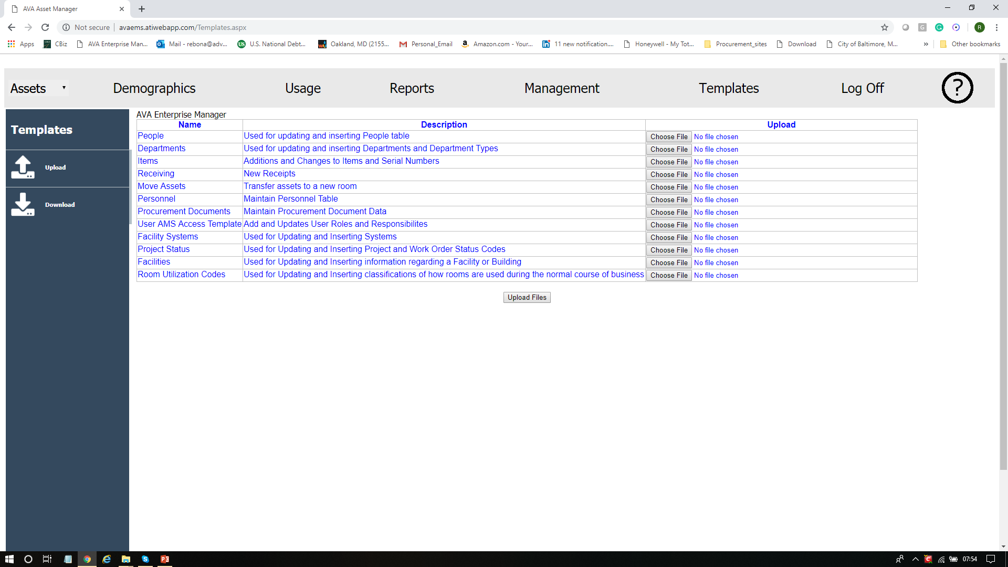
Template Selection Screen (Upload)

Slide 25
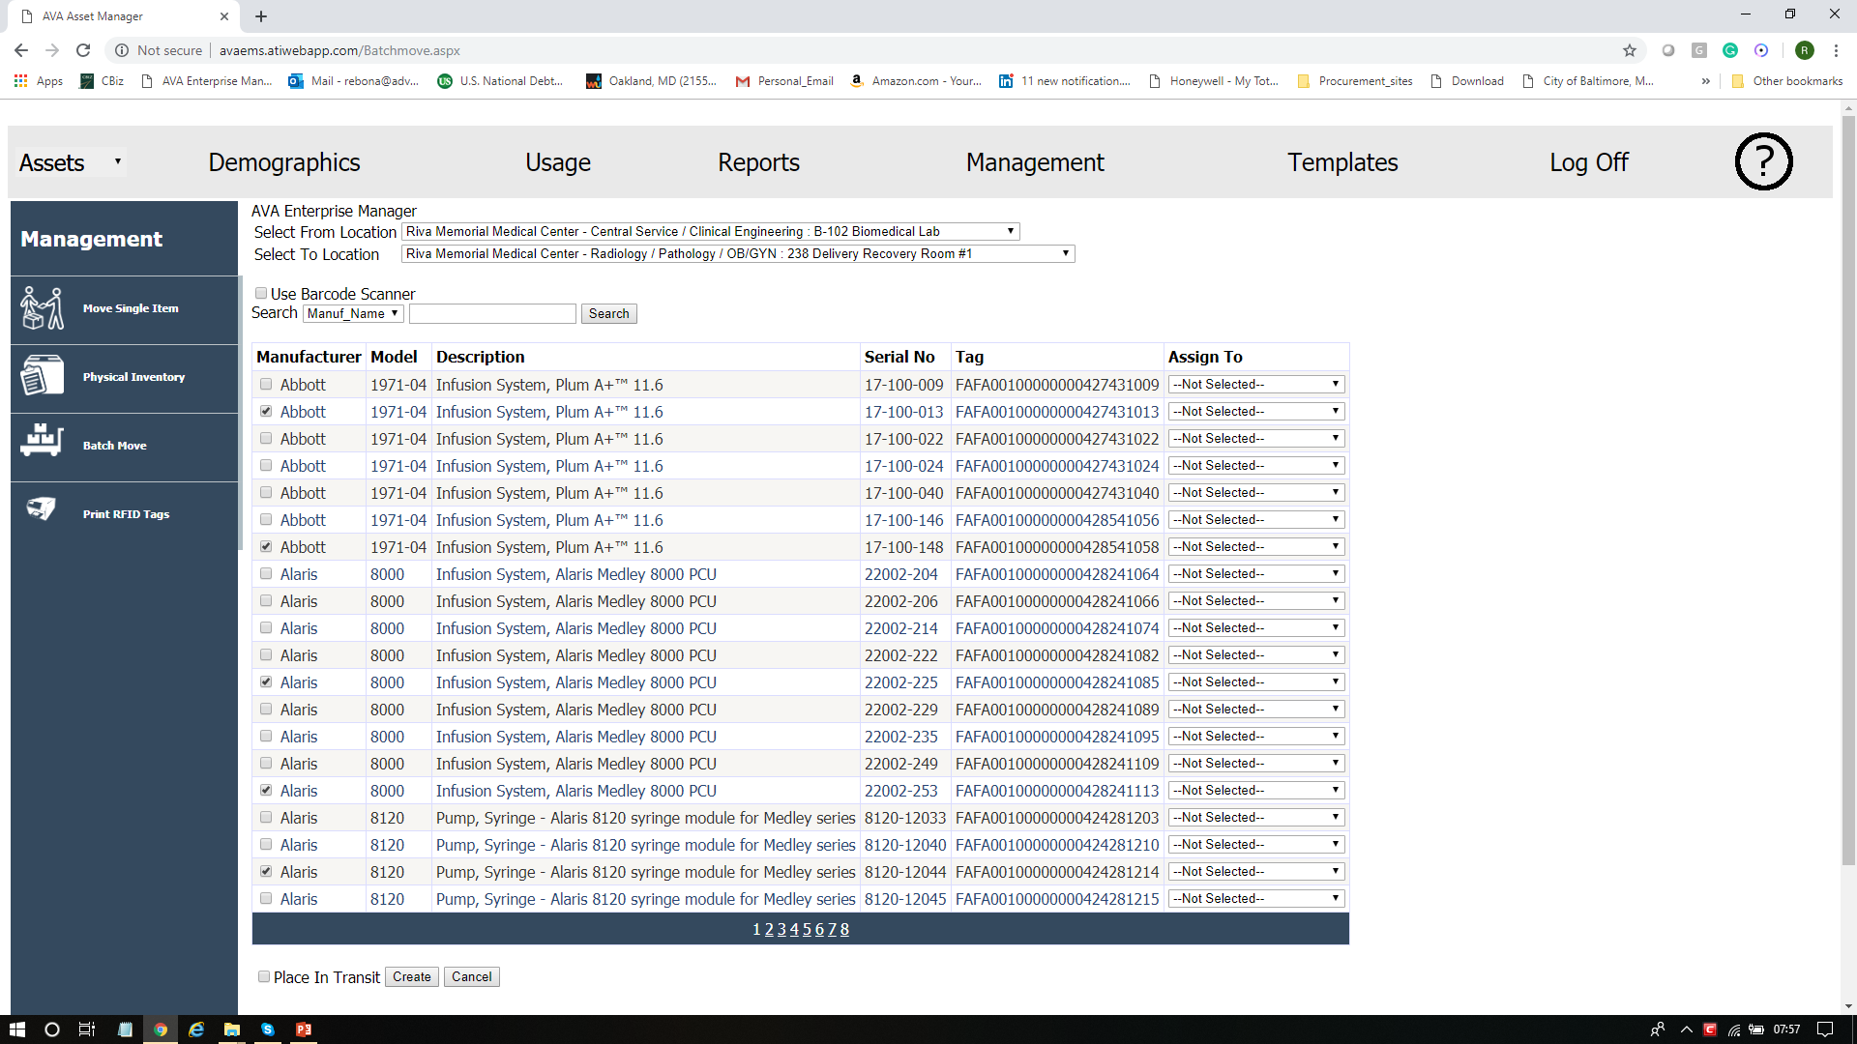
Asset Move Selection

Slide 26
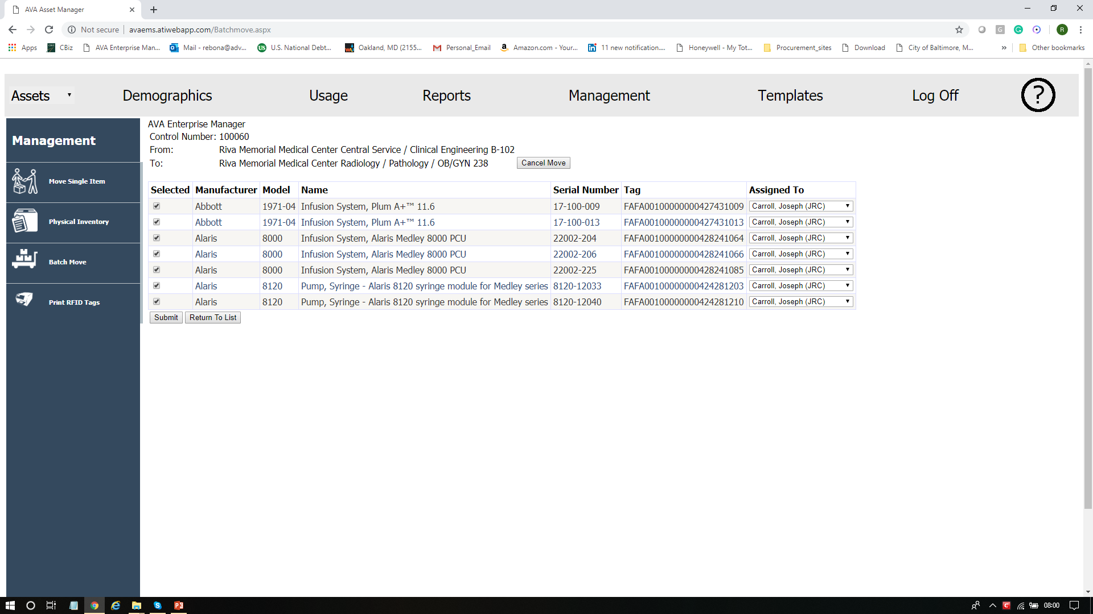
Asset Move Acceptance

Slide 27
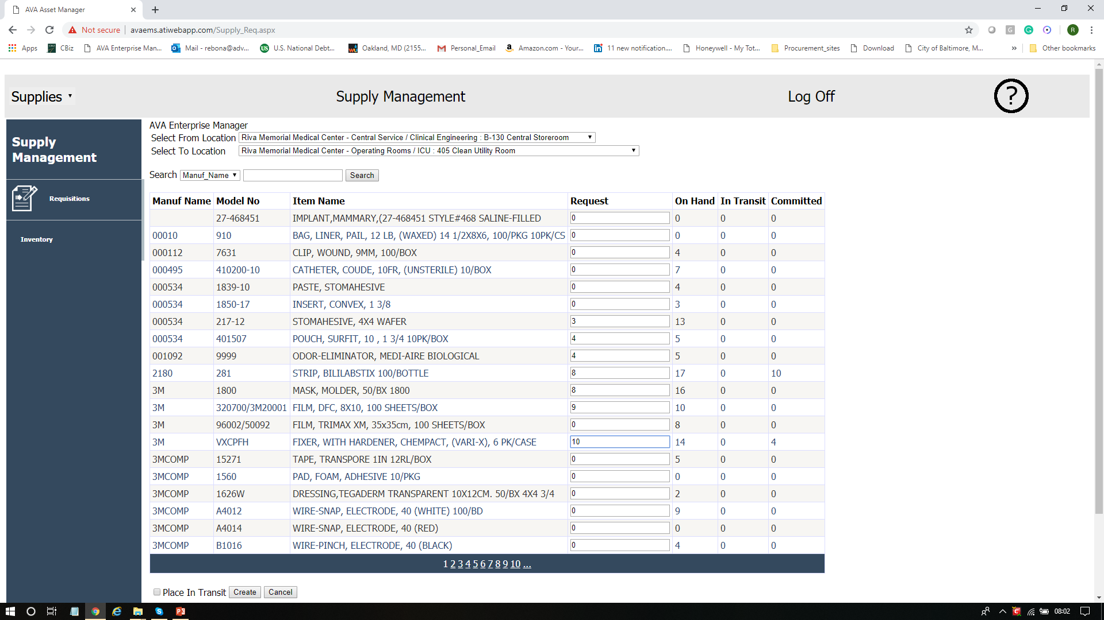
Supply Move Selection

Slide 28
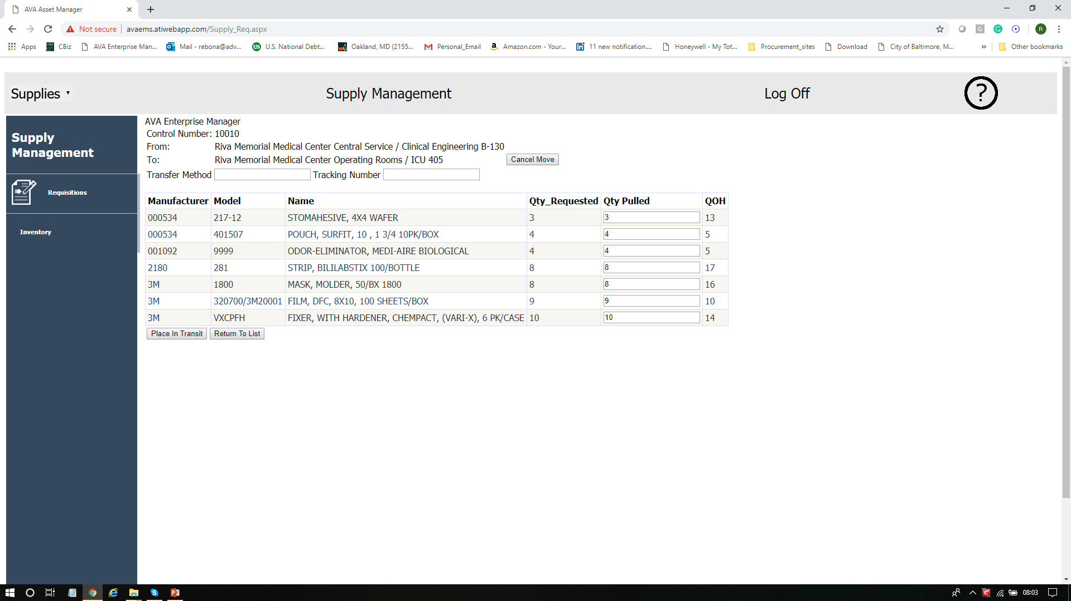
Supply Move Quantities Picked

Slide 29
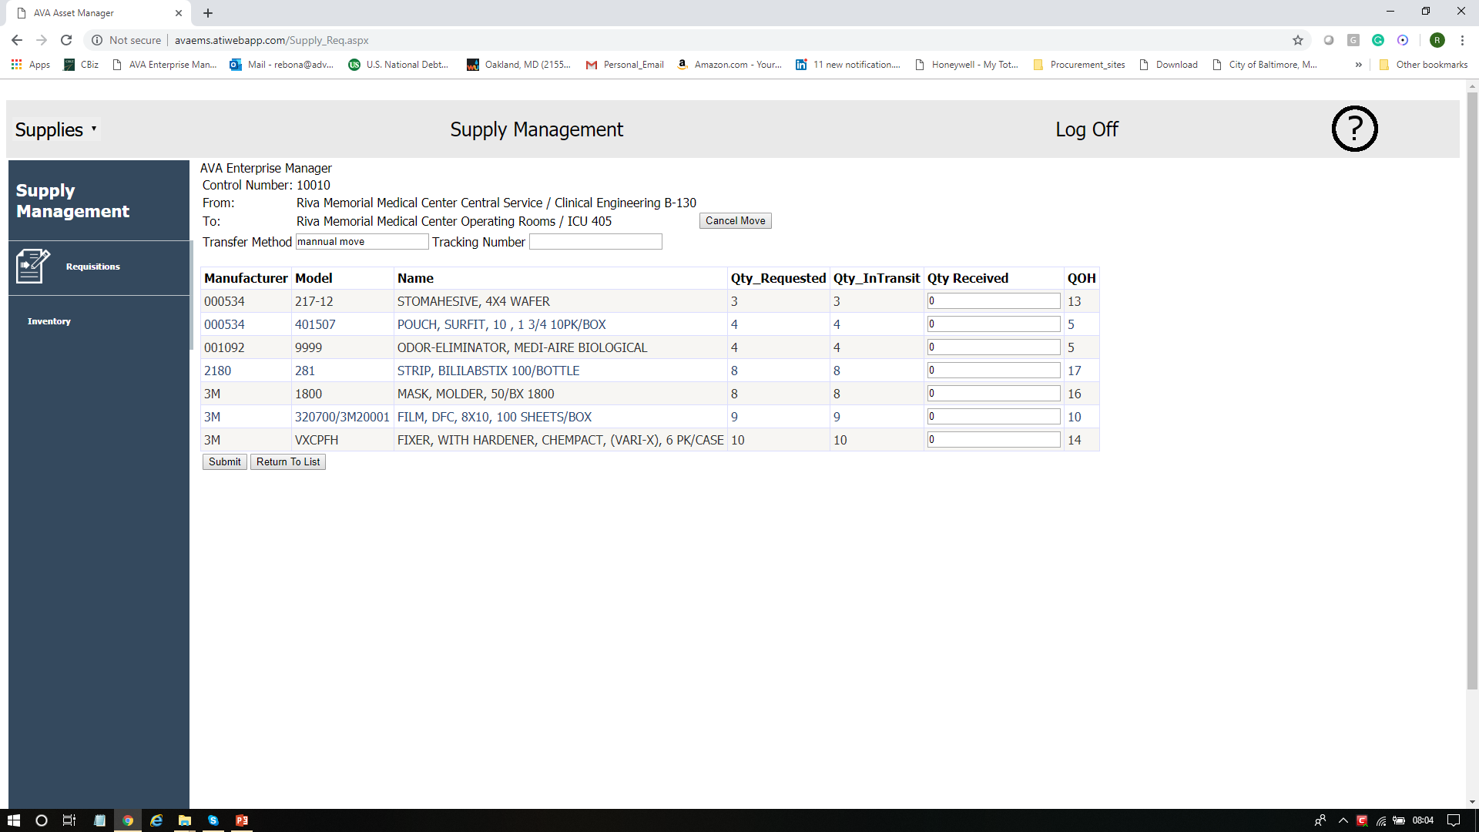
Supply Move Quantities Accepted

Slide 30
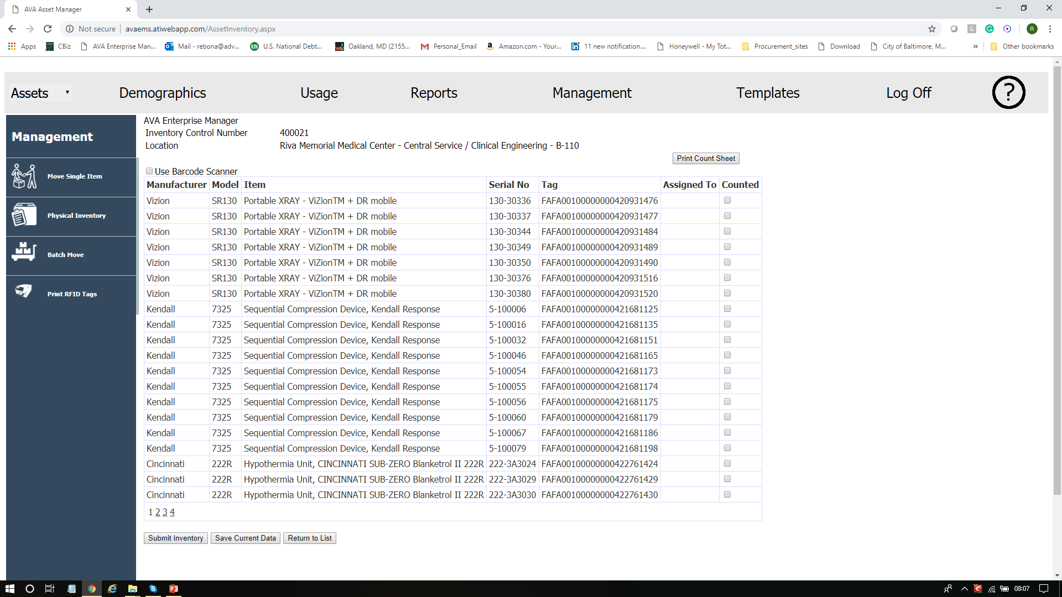
Asset Physical Inventory Count

Slide 31
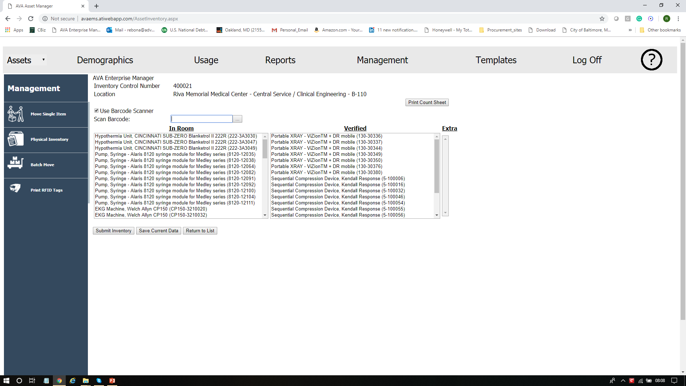
Asset Physical Inventory using Handheld Scanner

Slide 32
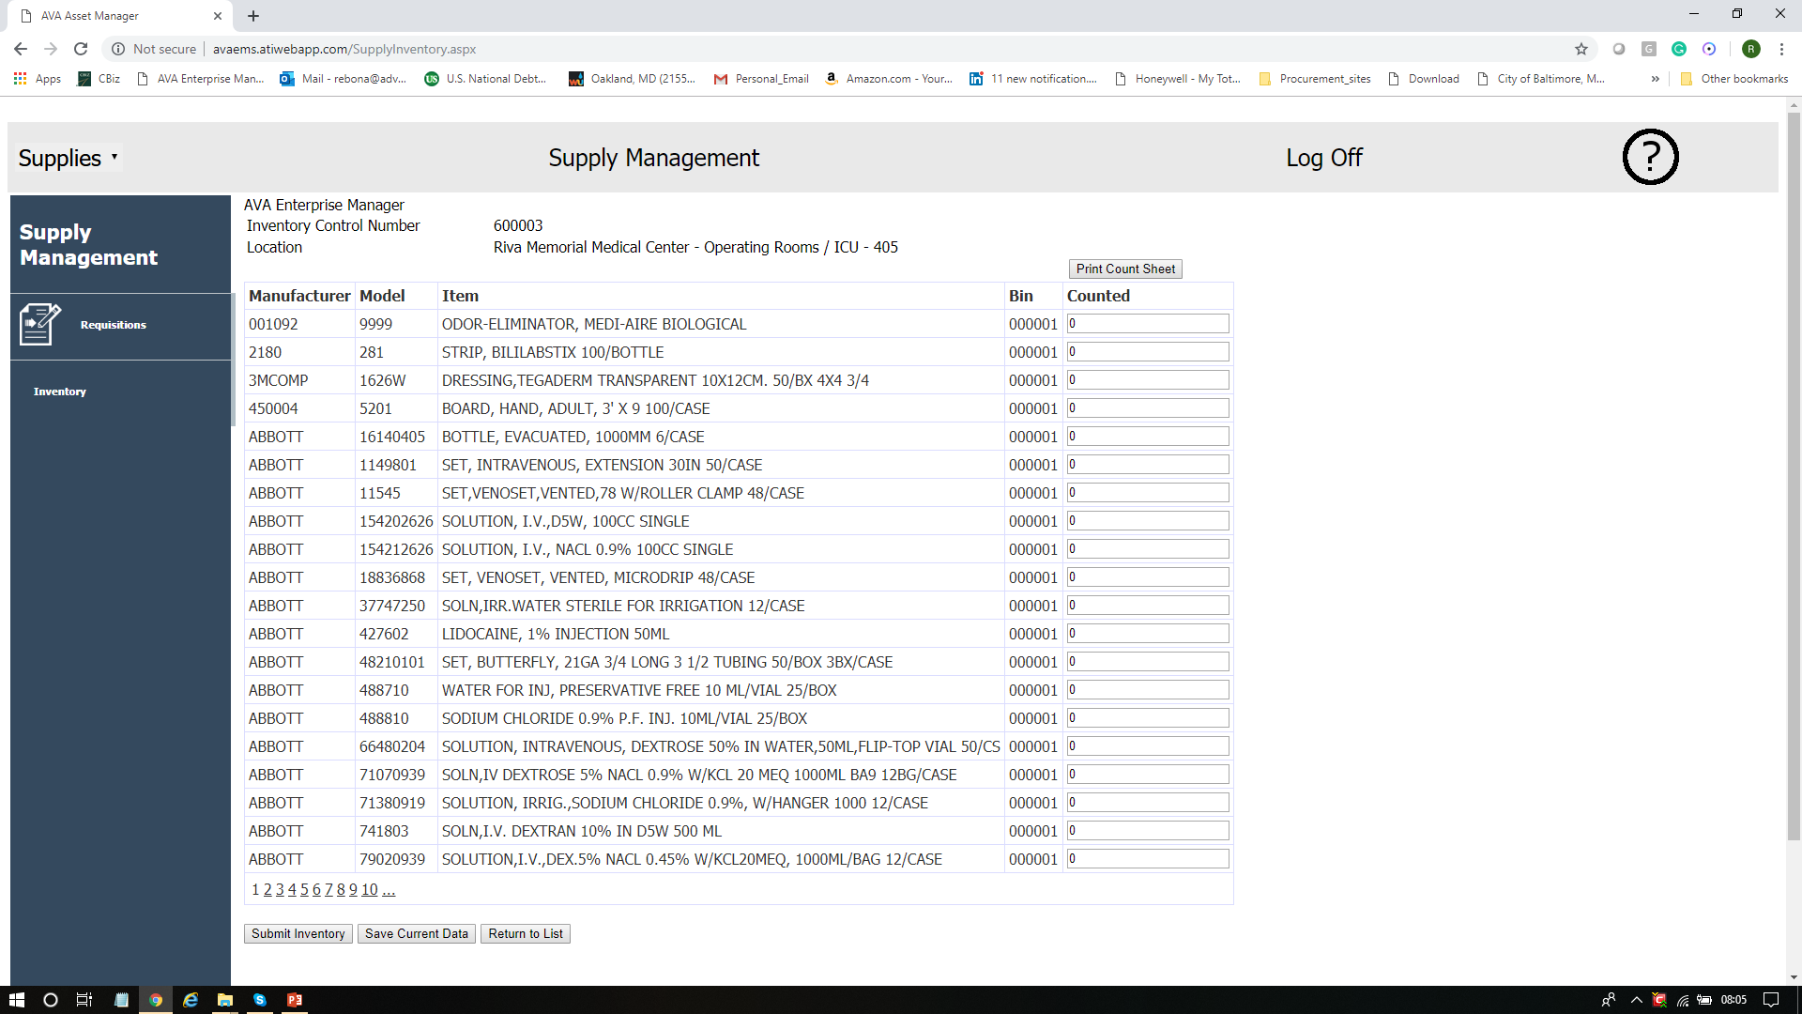
Supply Physical Inventory Count

Slide 33
Asset Management Reports

